Slide 1
Tableau
Introduction
-Ashu Mehta

Slide 2
What is tableau?
Tableau is the powerful data visualization tool.
Tableau is a business intelligence tool which helps us to analyze the raw data in the form of the visual manner; it may be a graph, report, etc.
Example: - If you have any data like Big Data, Hadoop, SQL, or any cloud data and you want to analyze that given data in the form of pictorial representation, you can use Tableau.

Slide 3
Tools
Tableau desktop
Tableau Online
Tableau Server
Tableau Reader
Tableau Public

Slide 4
Introduction to interface
Connections
Data source
Selected table details
Table name, no. of fields, no. of rows, data preview
Creating Worksheet, dashboard, story

Slide 5
Understanding different components
Menu bar, Quick access tool bar
Cards
Pages
Filters
Marks
Rows
Columns
Shelves
Sheet
Renaming sheet
Caption

Slide 6
Working with data
Dimensions vs measures
Connection types
Live vs Extract
Creating data tables
Auto-generated fields
Creating hierarchies
Sorting data
Groups vs Sets
Joining vs blending

Slide 7
Dimensions vs Measures
Dimension and measure play an important role in tableau visualization.
When we import any kind of data from any format, it gets separated into two major factors that are dimension and measure.
Dimension is the qualitative information of the data and Measure is the quantity of the data.
For eg- location, country, the date is the dimension of the data. Data that contains numbers like profit, a discount is a measure of the data.

Slide 8
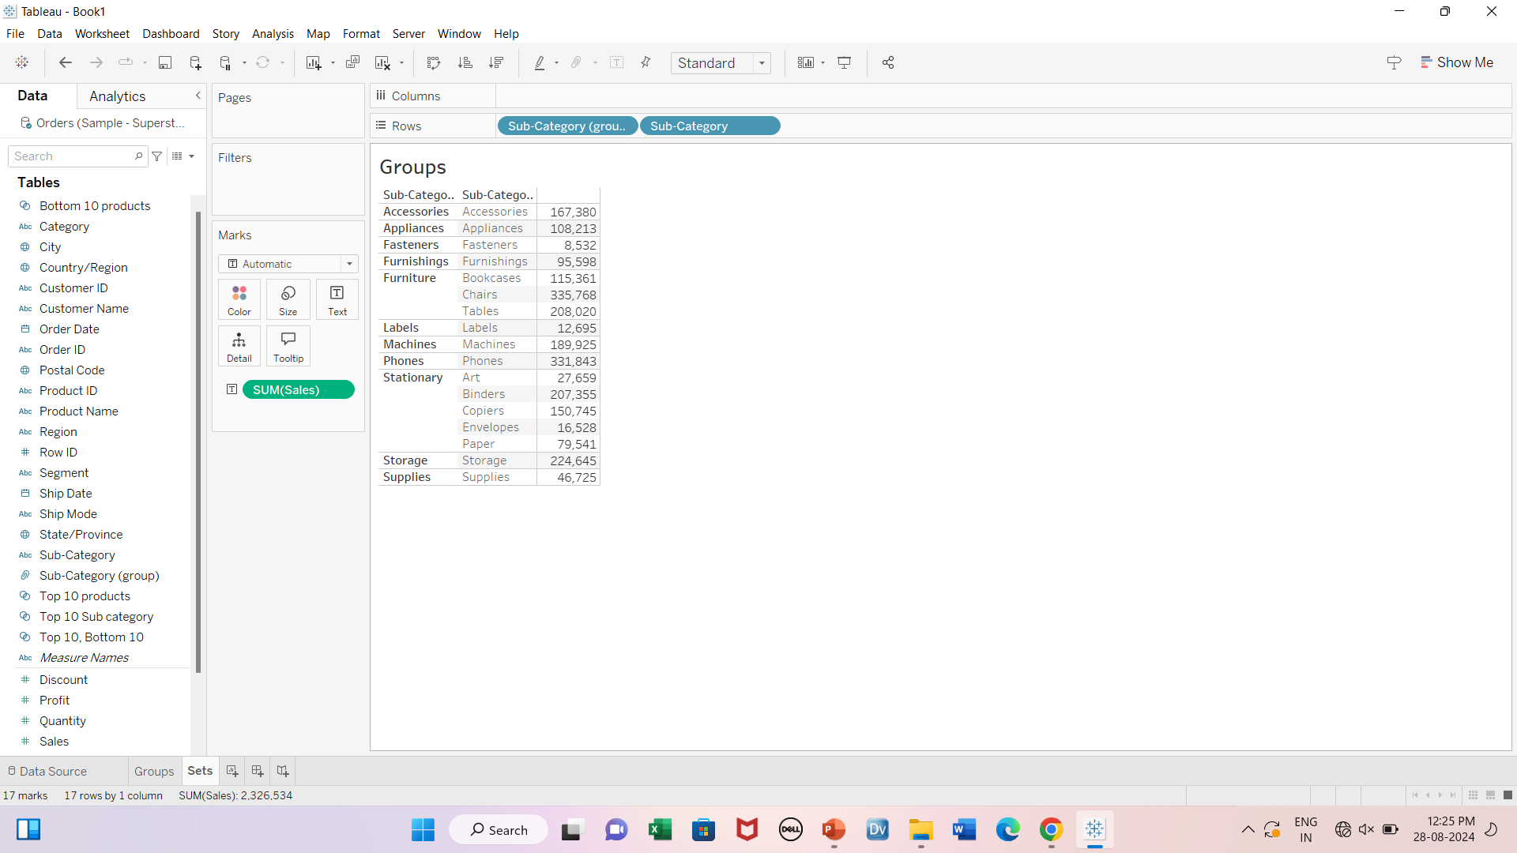
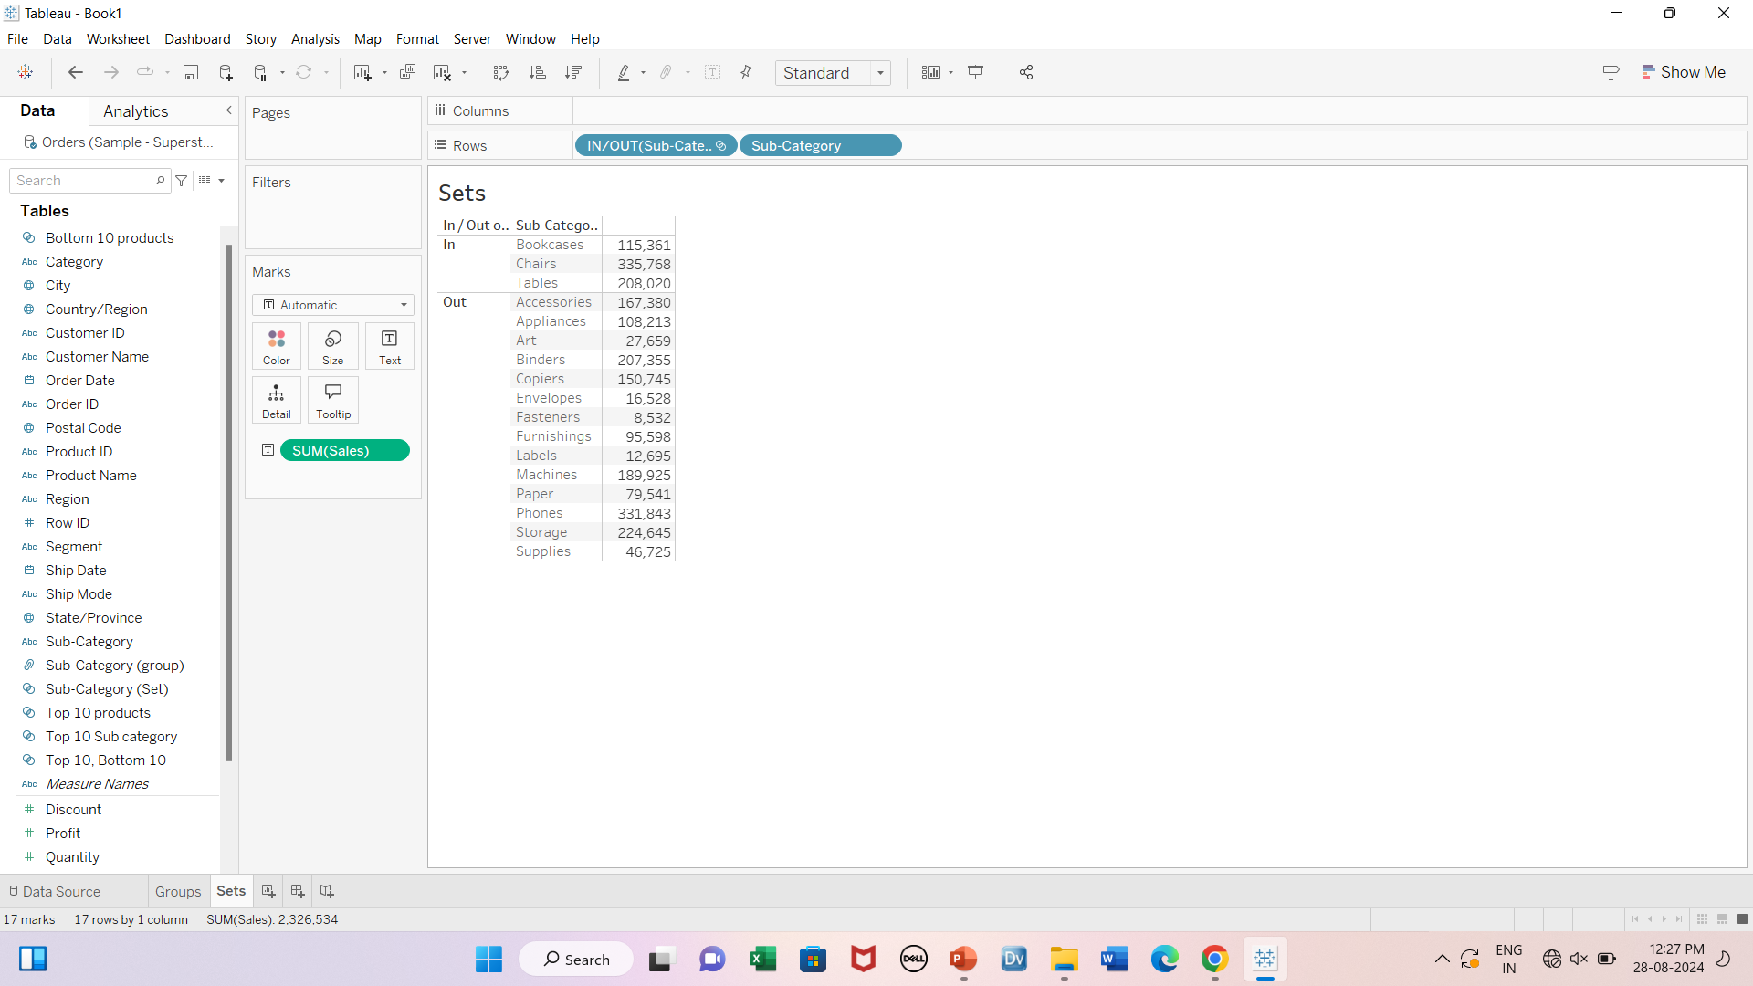
Groups vs Sets
Groups
Sets

Slide 9
Activity
Create a group for Product Name having 3 groups
Computer
Phone
Other

Slide 10
Sets
Static sets (set of any N items)
Dynamic sets (set of items that matches a condition)
Combined sets
Combined sets can be created for sets of same field only. For eg-
Top 5 Customers and Bottom 5 customers-Yes
Top 5 customers and Bottom 5 Product names-No

Slide 11
Activity
Create a set for Top 5 products based on total sales
Create another set for Bottom 5 products based on total sales
Create a combined set for Top 5 products and Bottom 5 products.

Slide 12
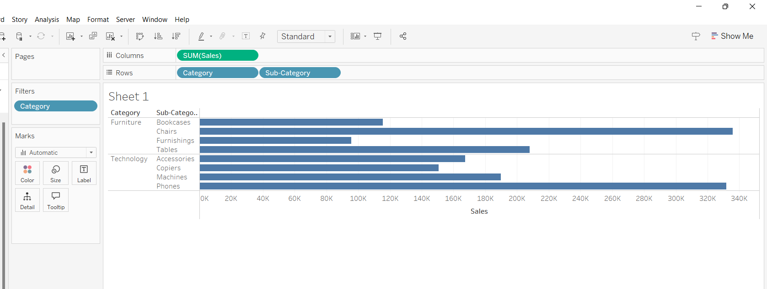
Filters

Slide 13
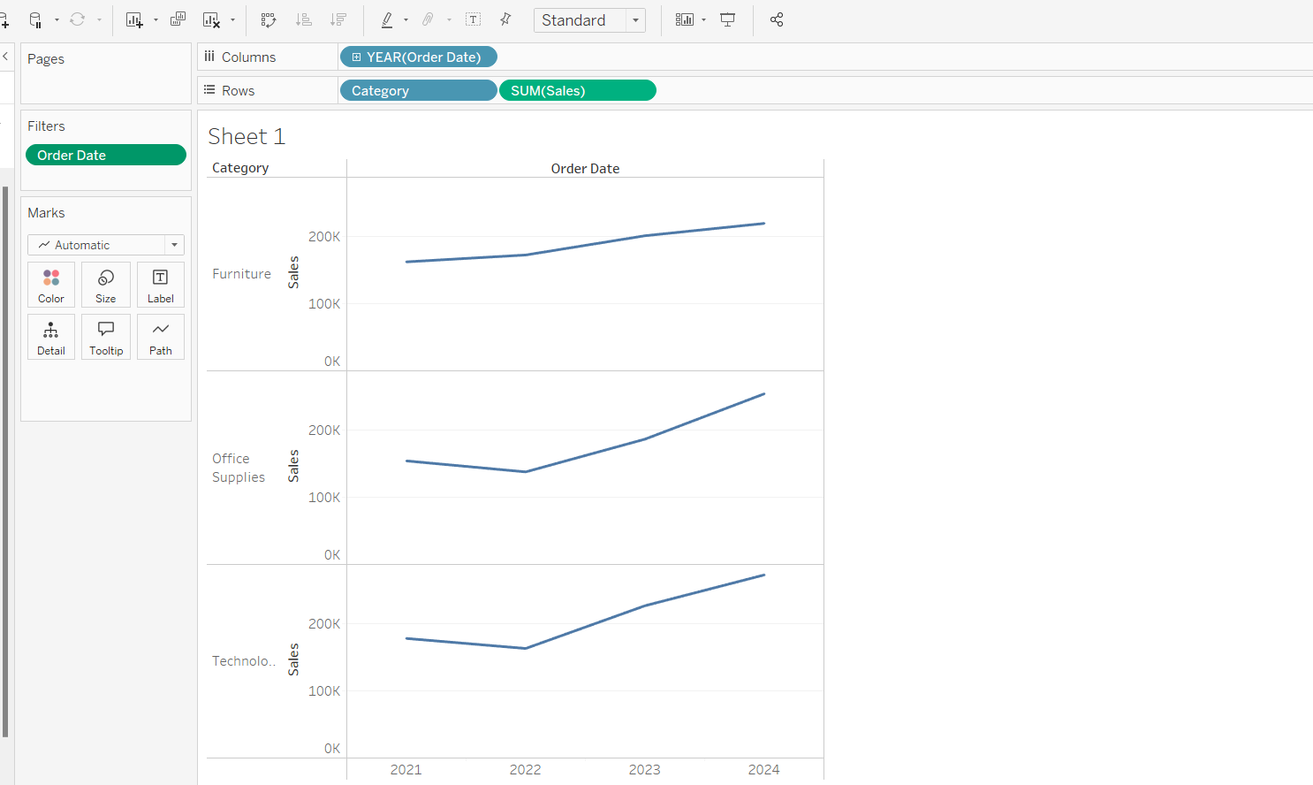
Filters- Date fields

Slide 14
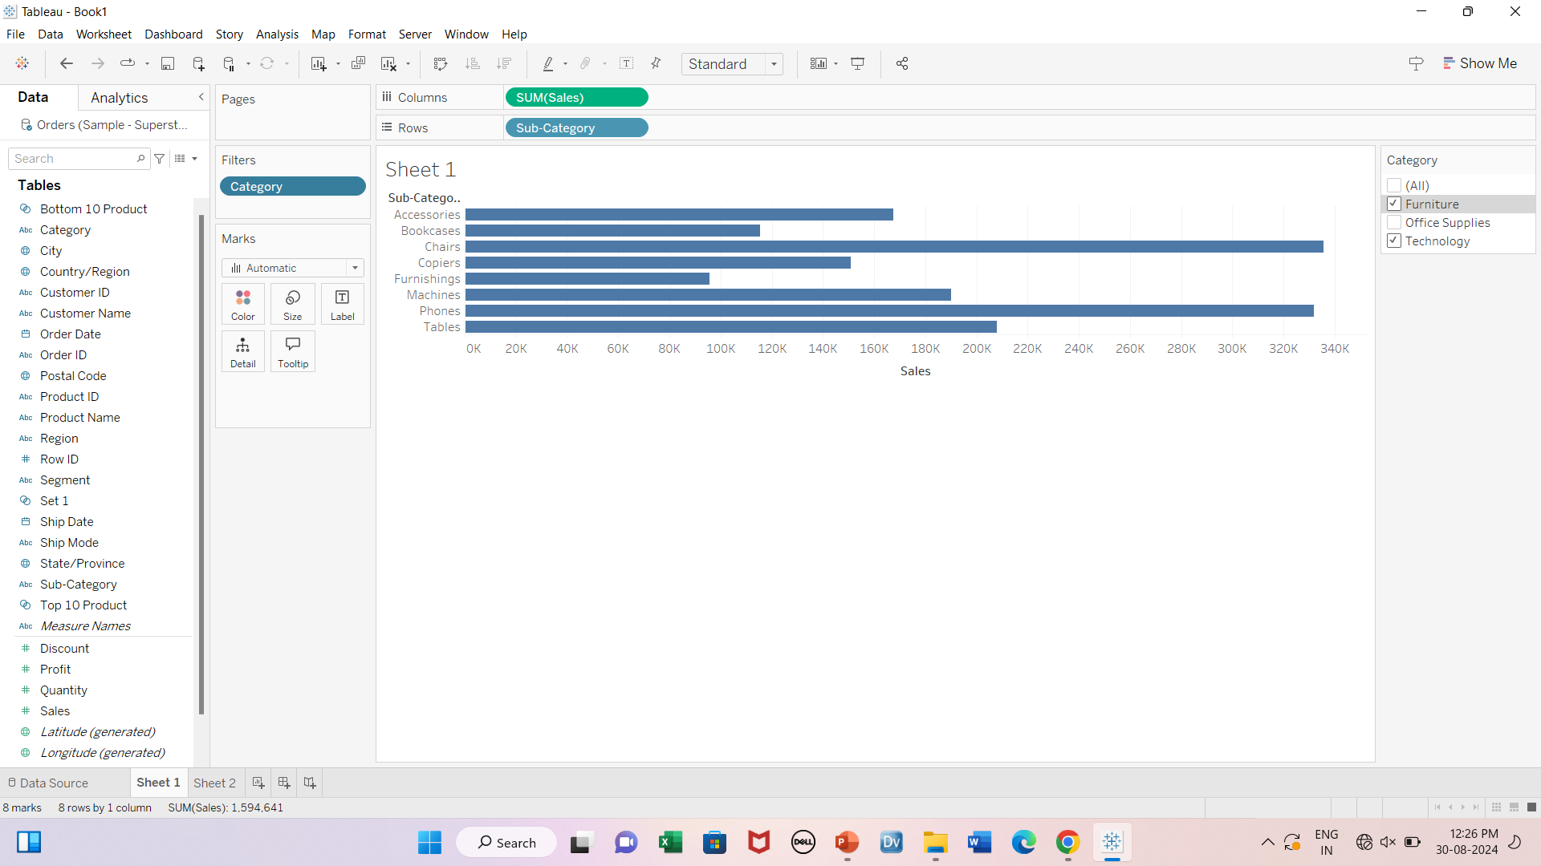

Interactive filters

Slide 15
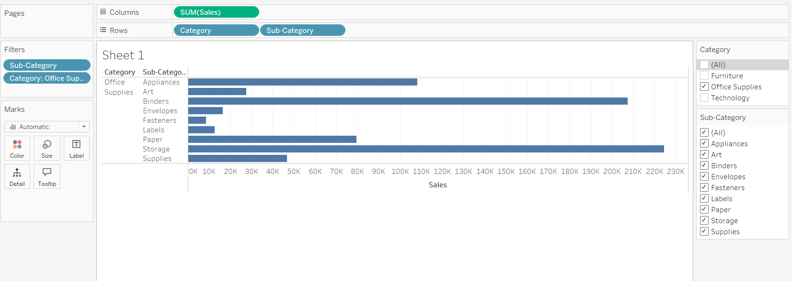

Dependent interactive filters

Slide 16
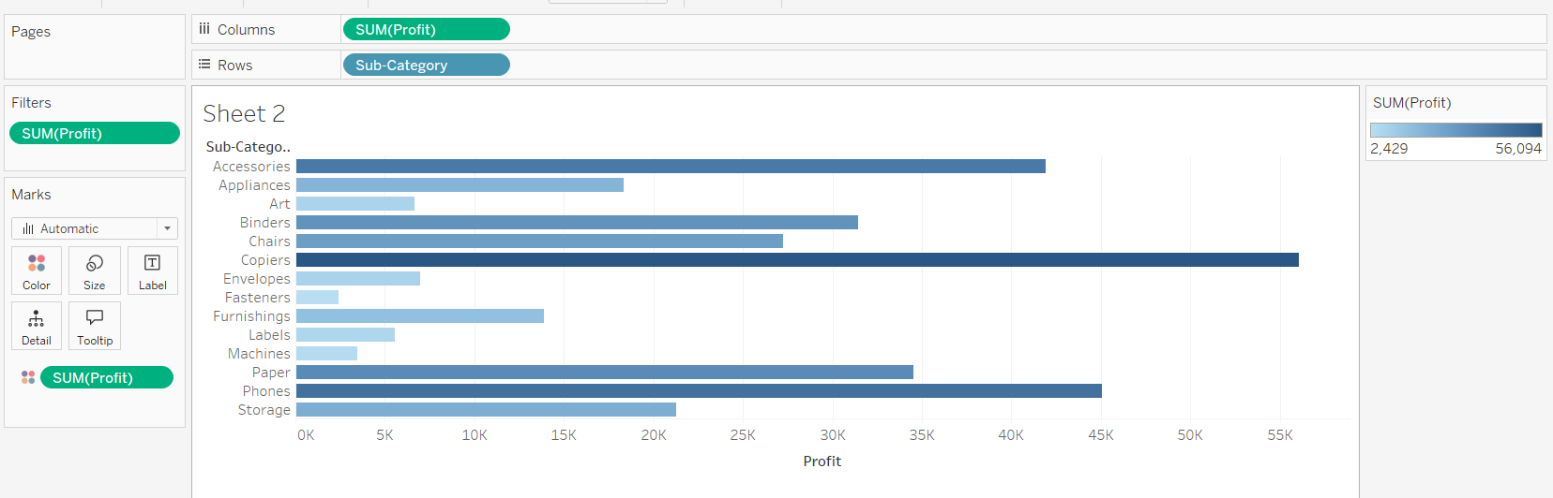
Filters(Based on Measures)
Filter- Sum(Profit) atleast 0

Slide 17
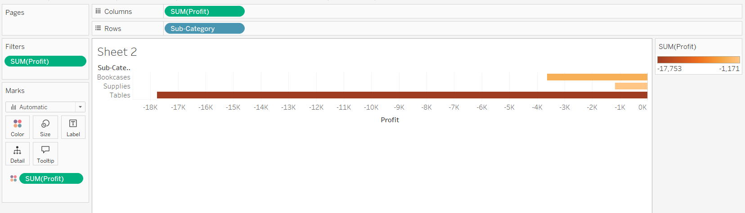
Filter- Sum(Profit) atmost 0

Slide 18
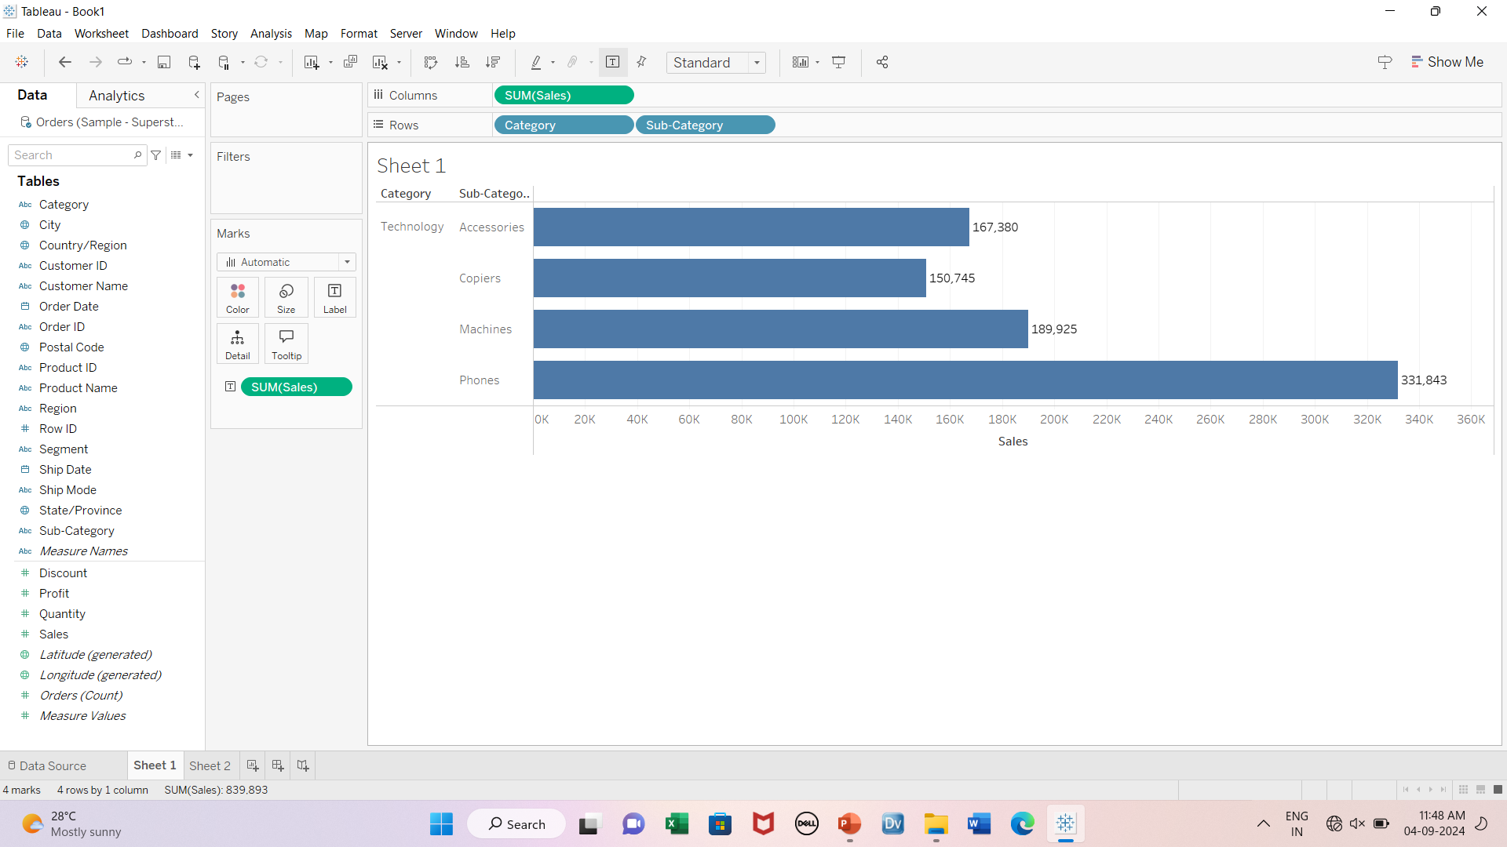
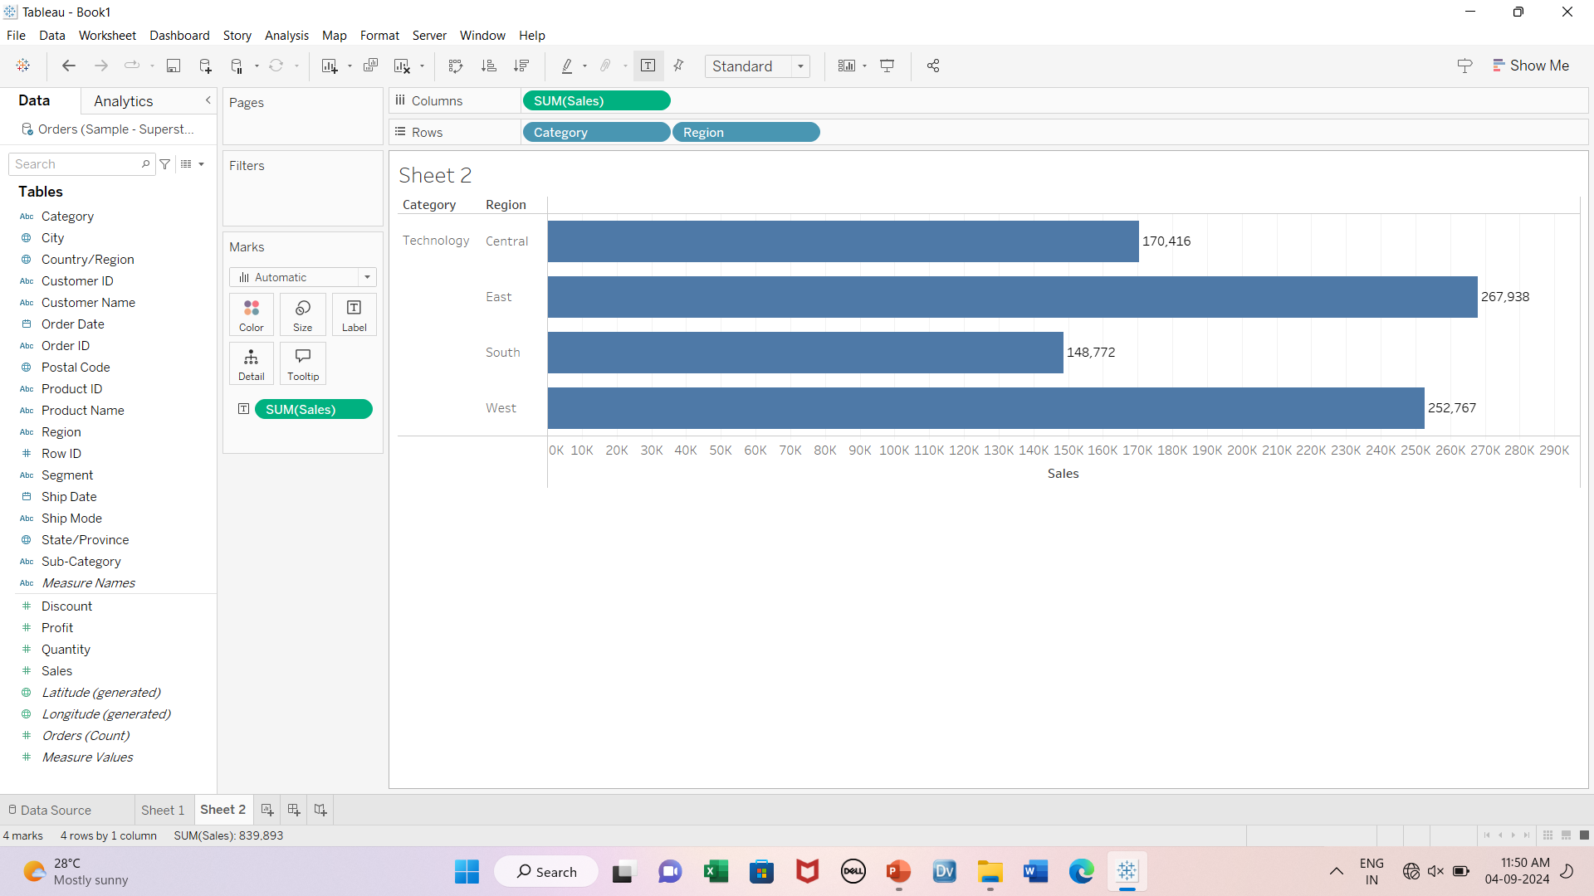
Data source Filters
Data source filter- category

Slide 19
Ways to filter
Filter shelf
Interactive filters
Headers
Legends

Slide 20
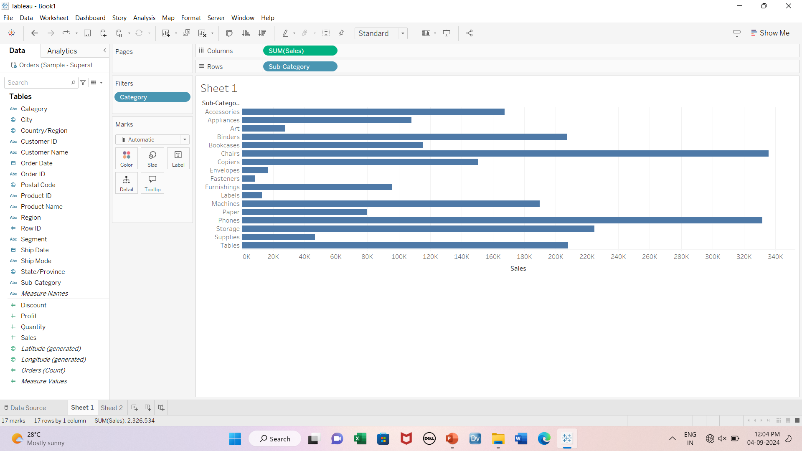

By filter shelf

Slide 21
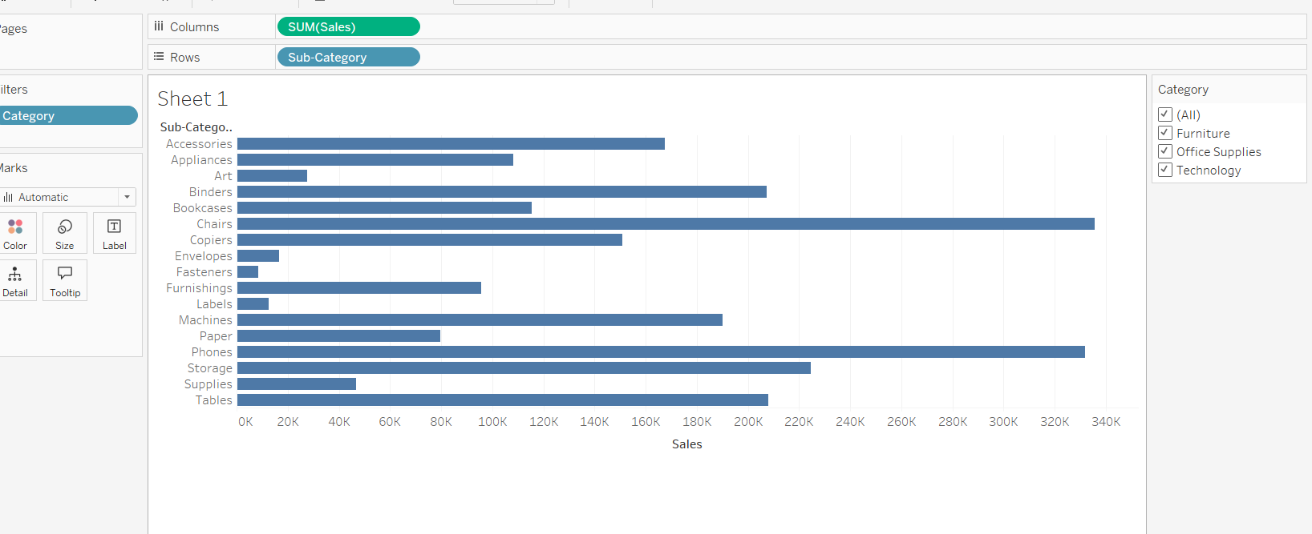

By interactive filter

Slide 22
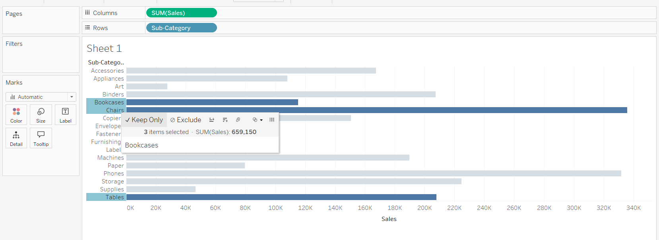

By header

Slide 23
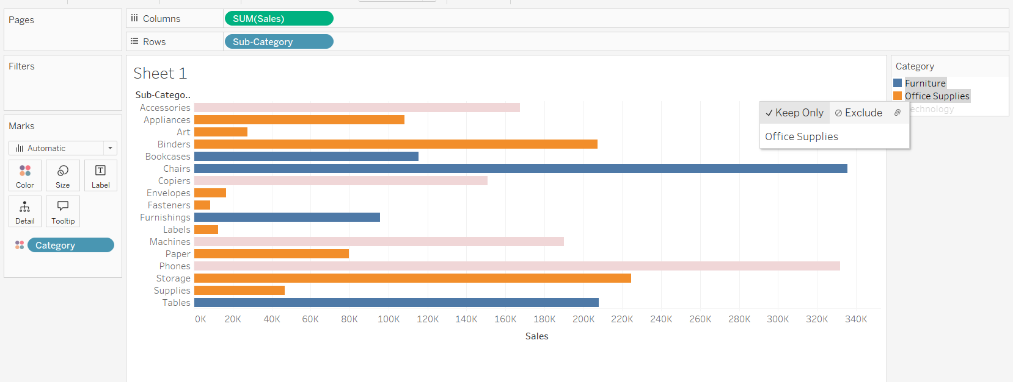

By Legends

Slide 24
Parameters
Create Top N parameter
Parameters with filters
Parameters with sets

Slide 25
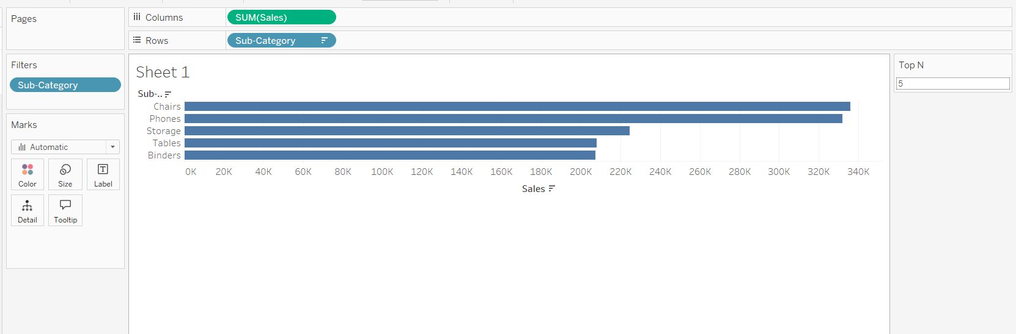
Parameters with filters

Slide 26
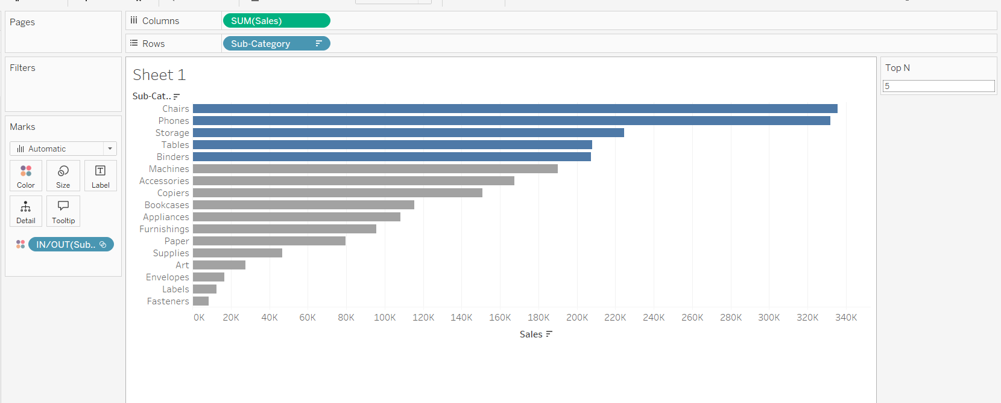
Parameters with sets

Slide 27
Discrete vs continuous
Discrete
Separate, distinct or individual
Blue pill
Gives Separate colours when a discrete field is dropped in colours
Gives Symbol map when a discrete field is dropped in colours
Note: dates can be treated as discrete or continuous
Continuous
Without pause
Green pill
Gives Gradient colours when a continuous field is dropped in colours
Gives a Filled map continuous field is dropped in colours when

Slide 28
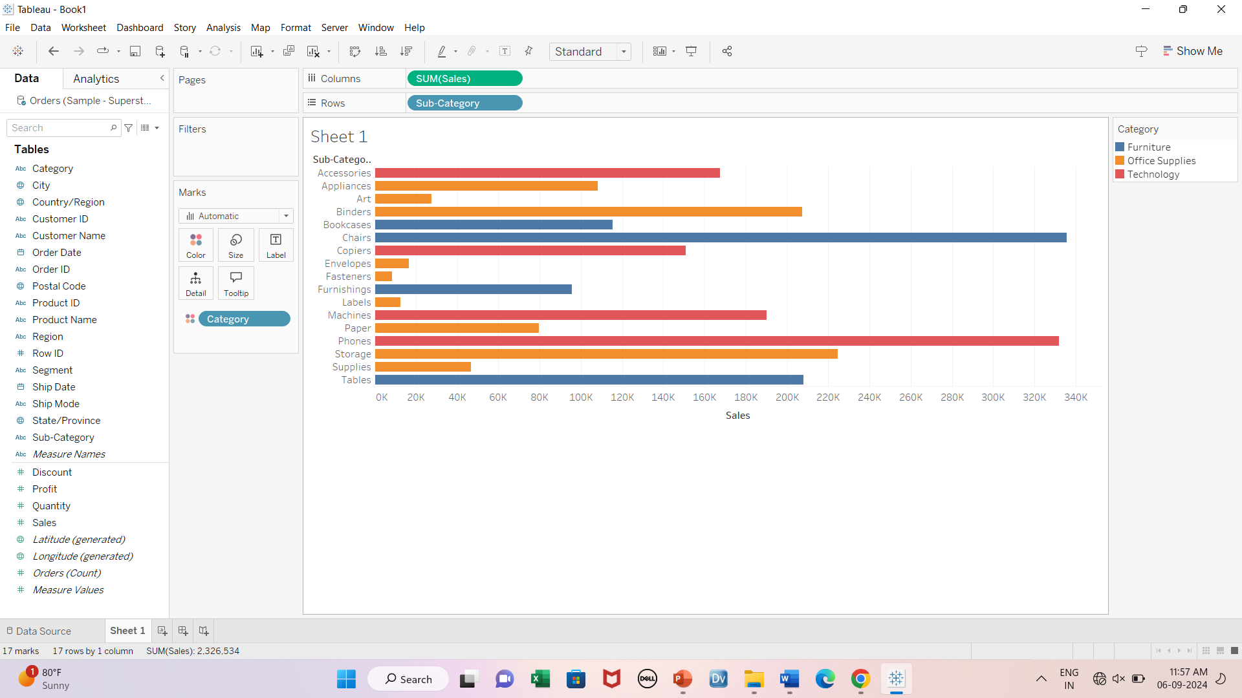
Effect of discrete & continuous fields on charts

Slide 29
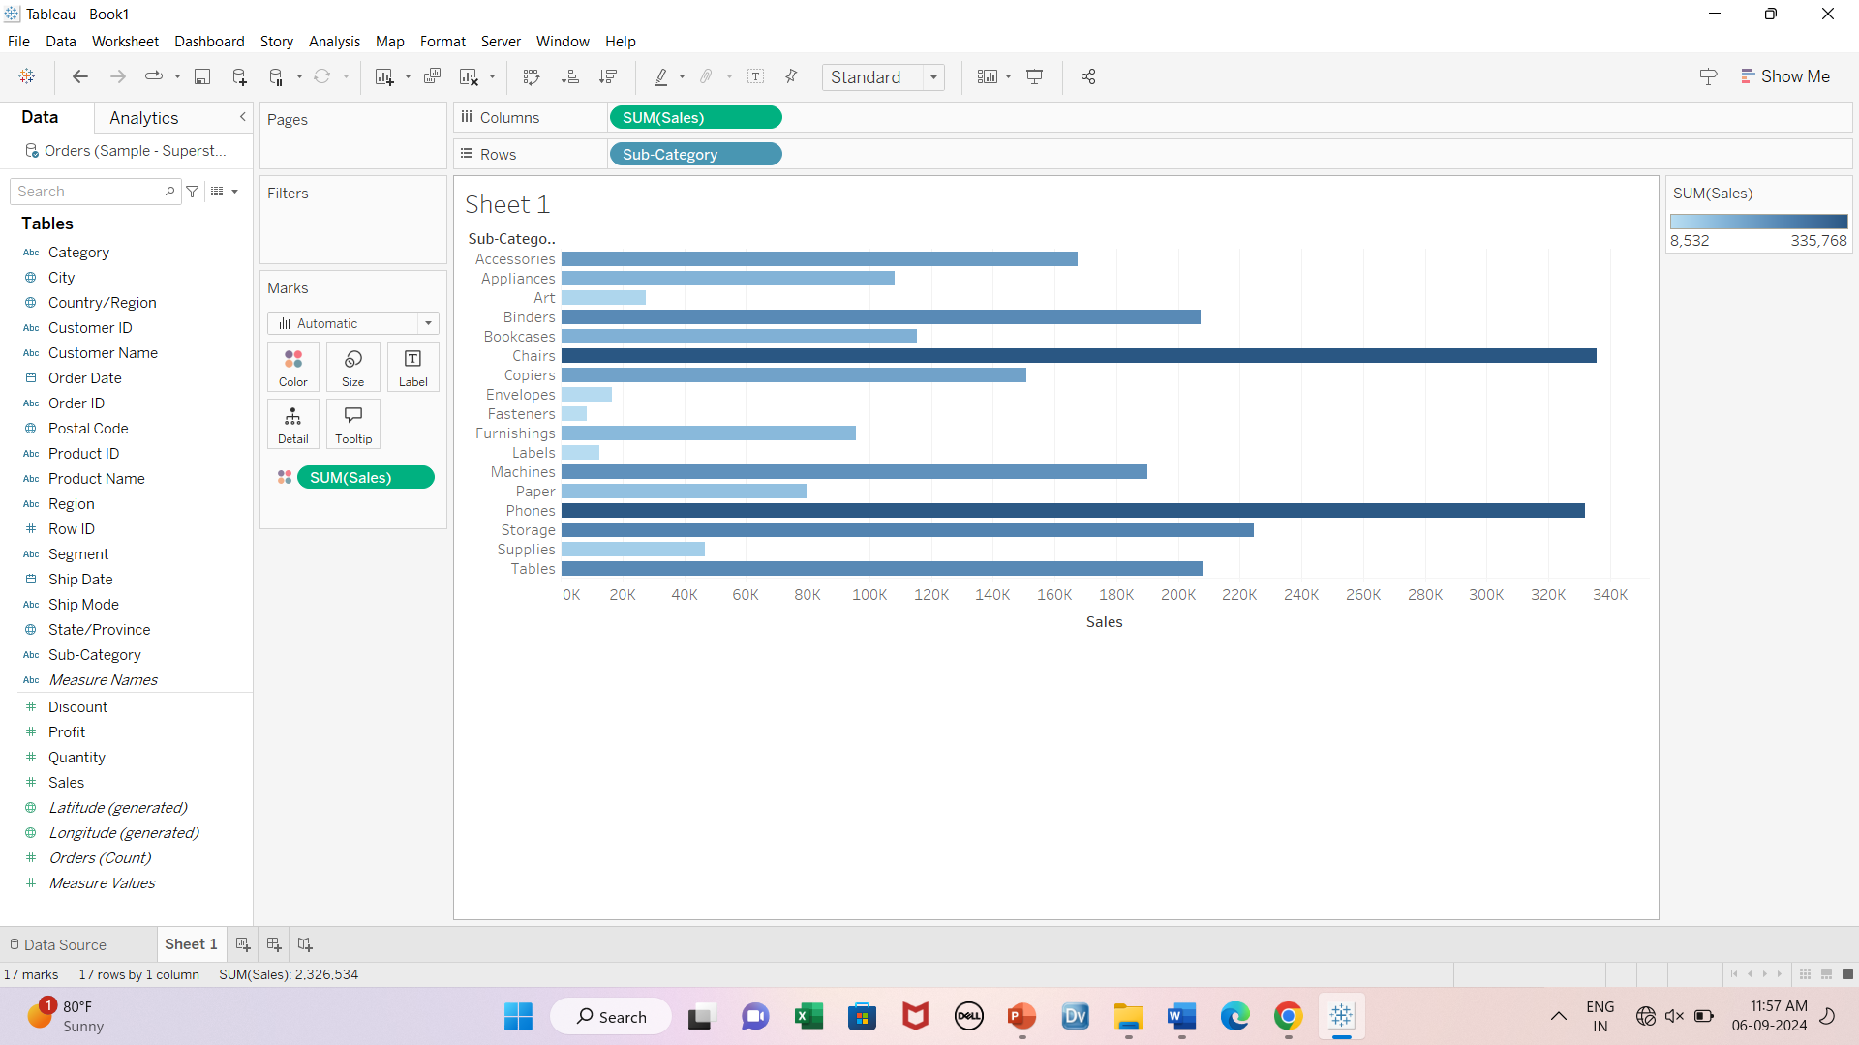
Effect of discrete & continuous fields on charts

Slide 30
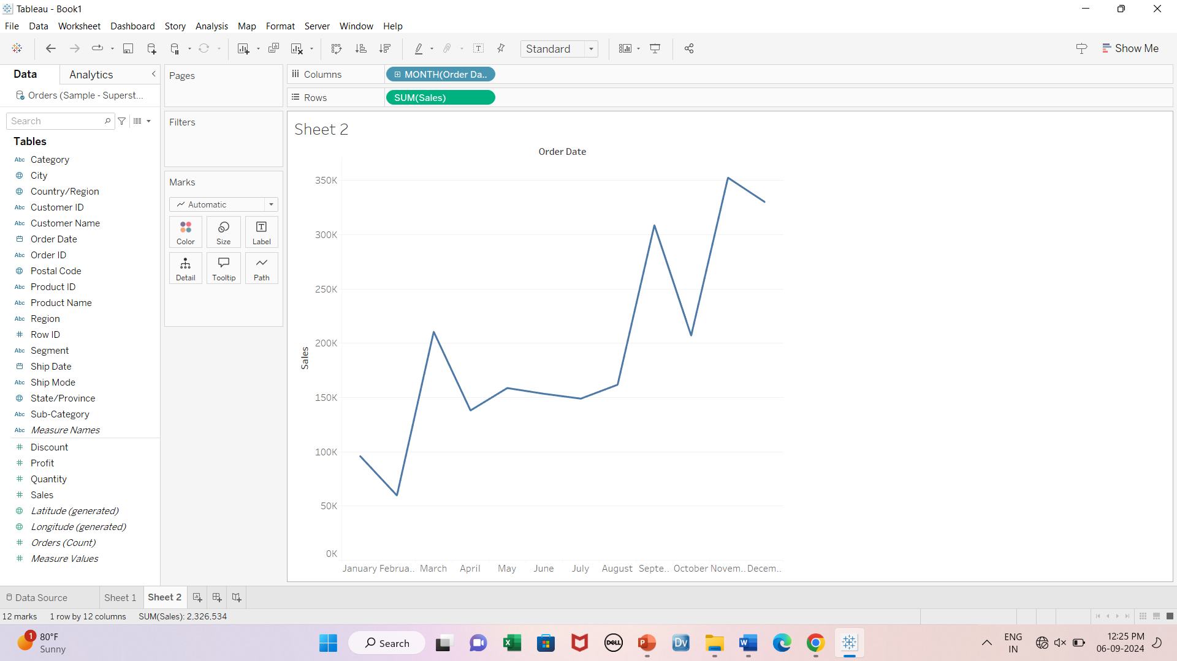
Date as discrete field

Slide 31
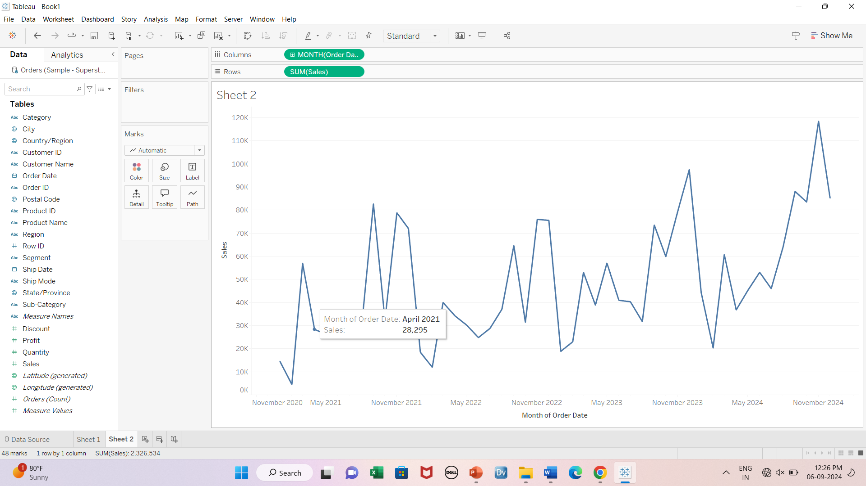
Date as continuous field

Slide 32
Calculated fields
Basic
Row level eg: continent, location
Aggregate eg: total sales, days to ship

Slide 33
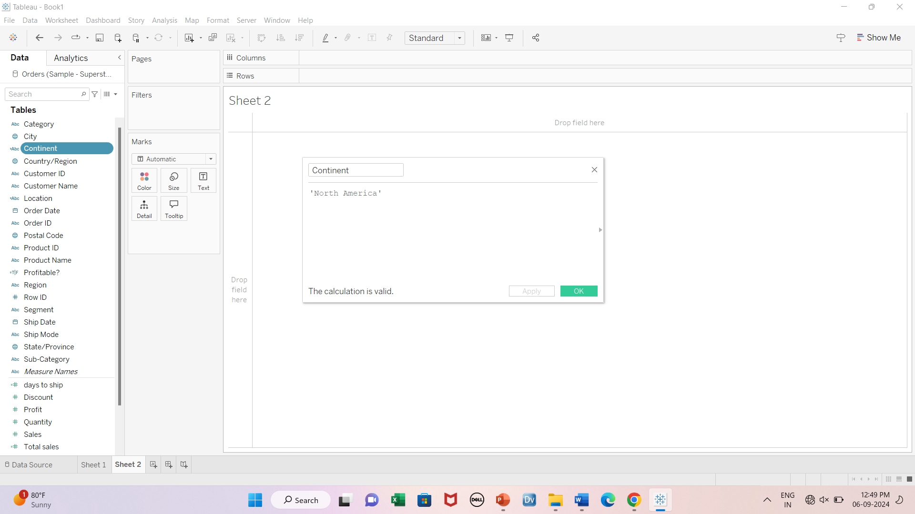
1-Continent

Slide 34
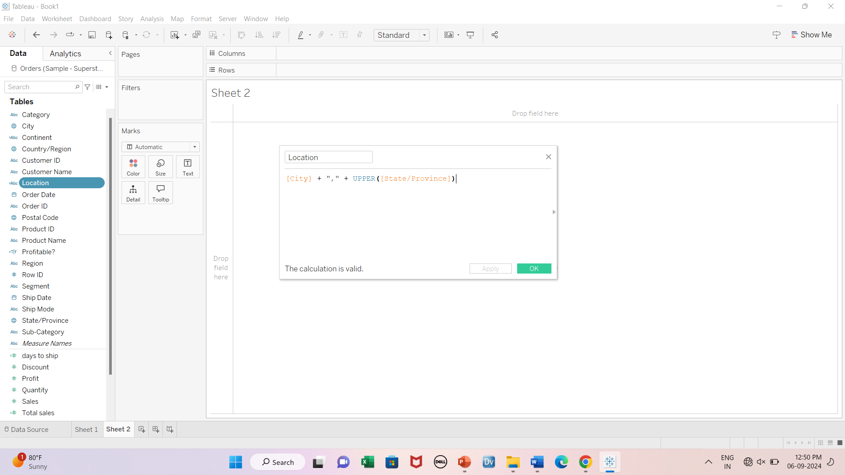
2-Location

Slide 35
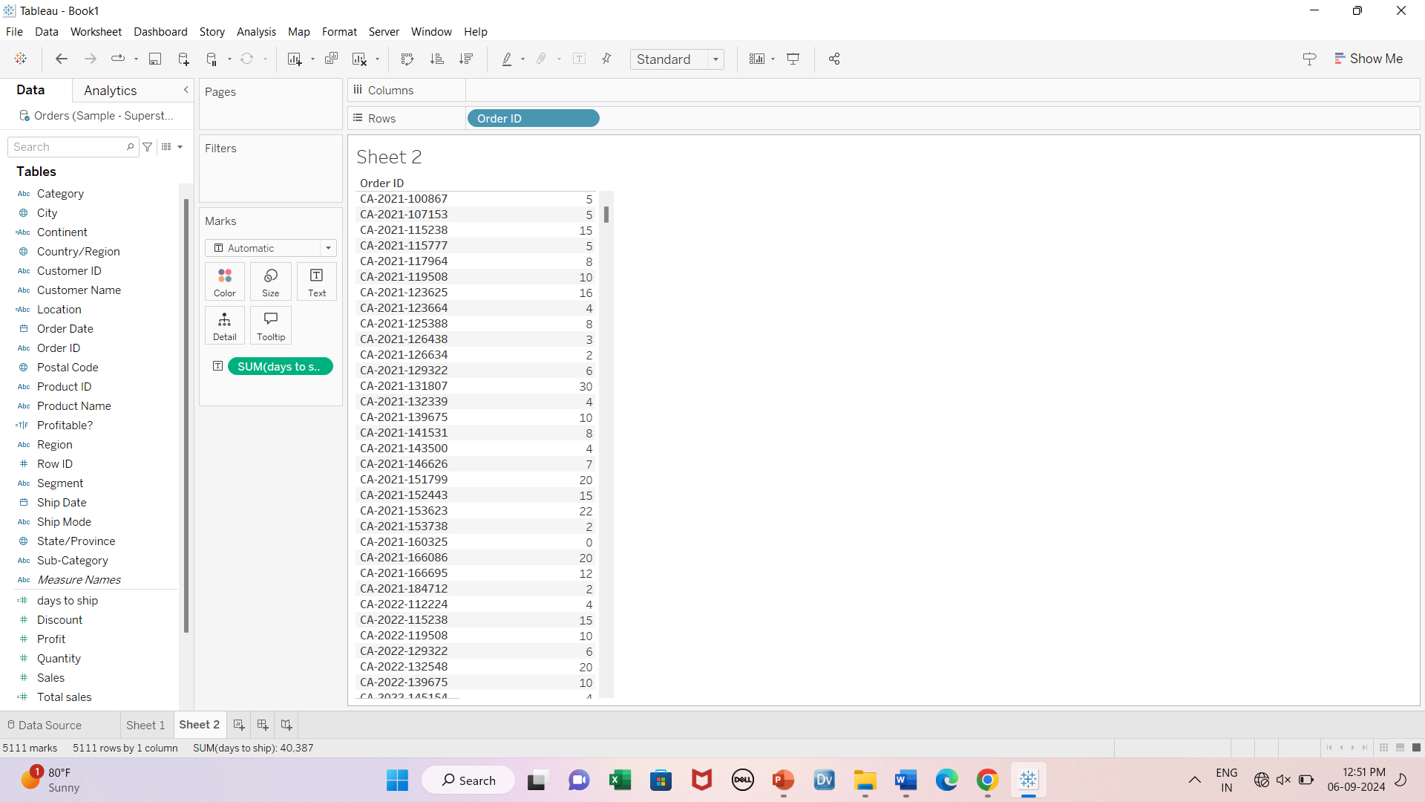
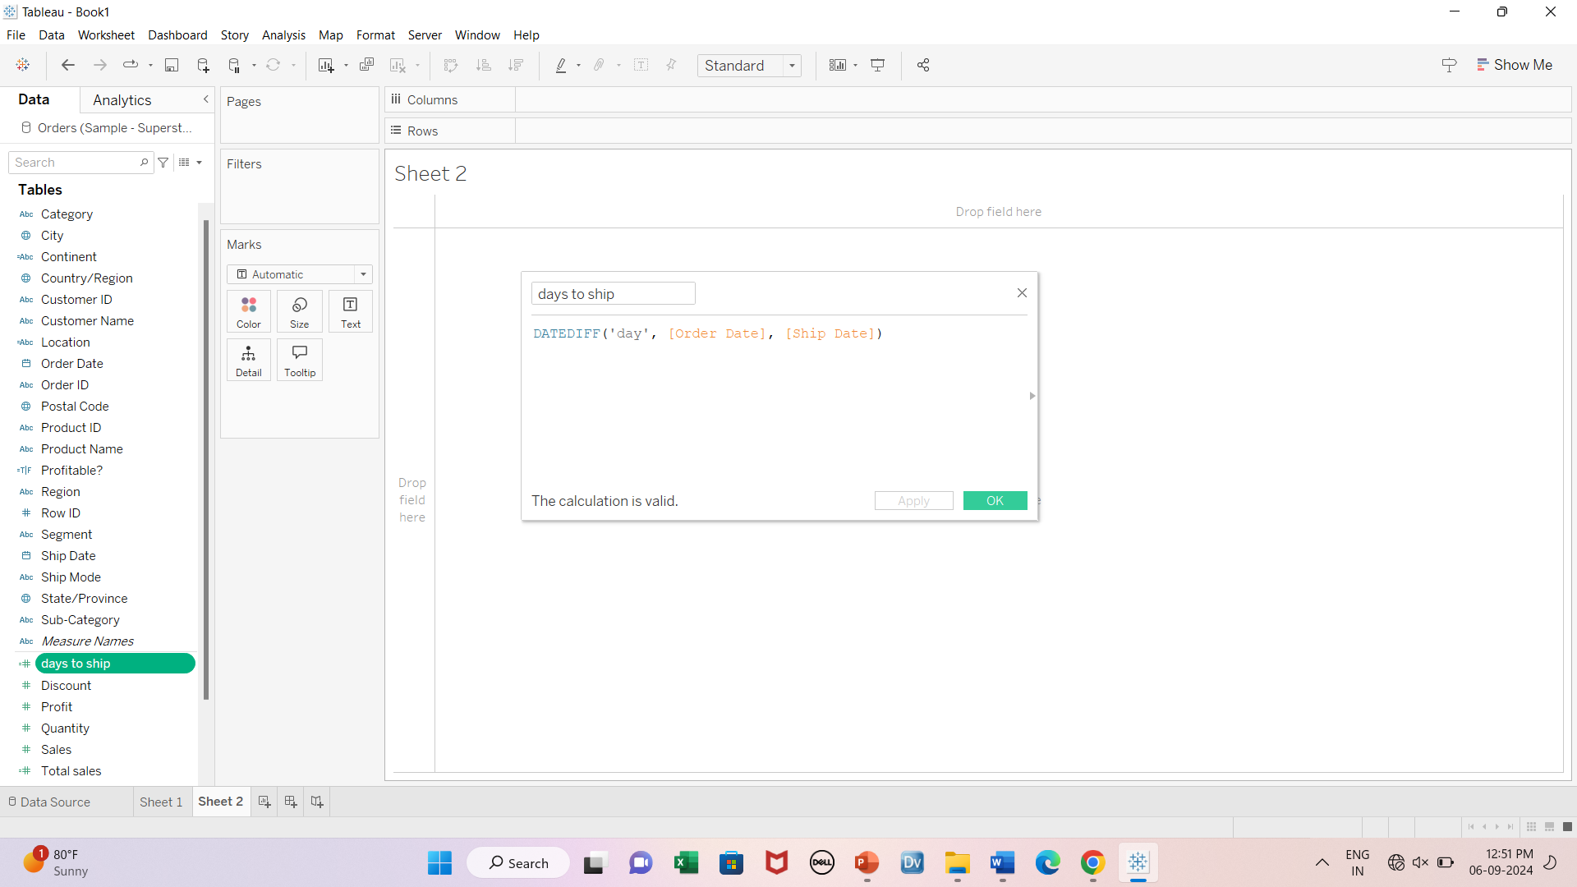
3-Days to ship

Slide 36
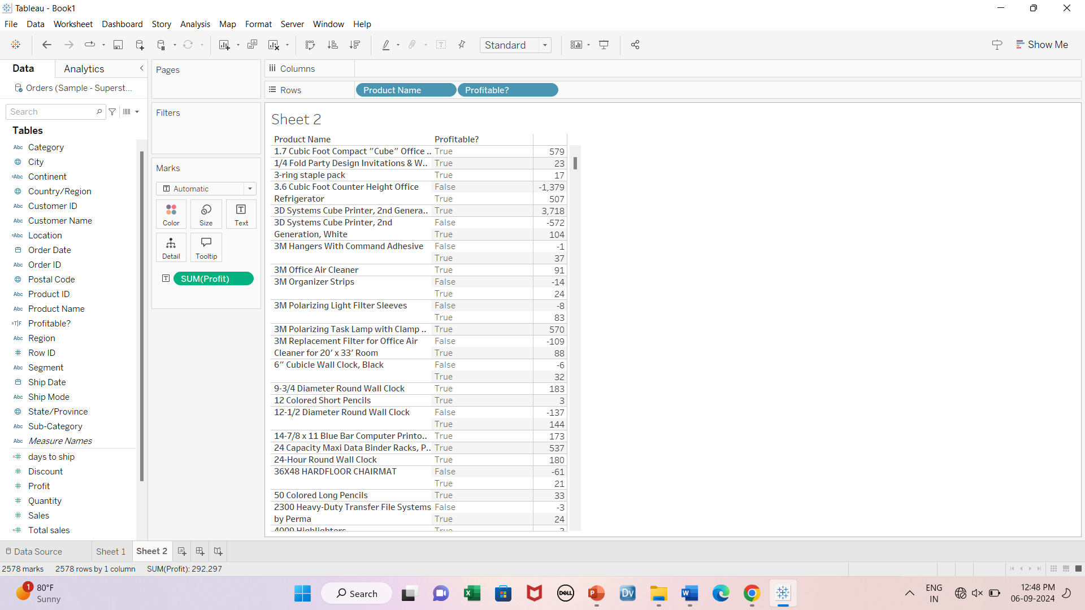
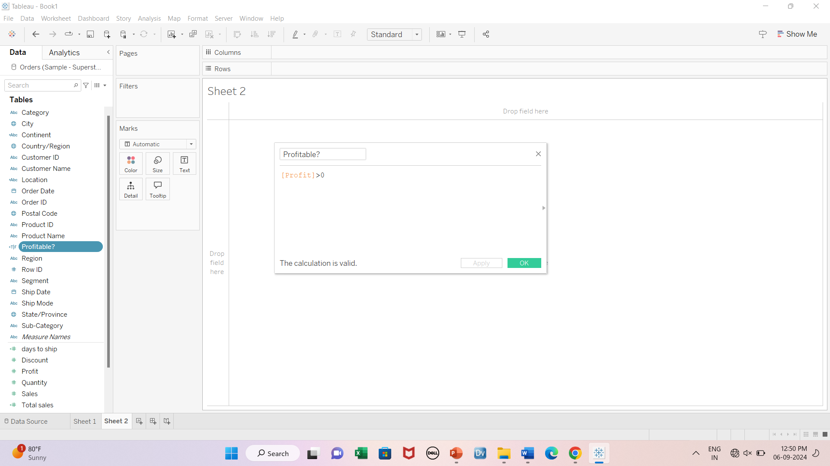
4-Profitable?

Slide 37
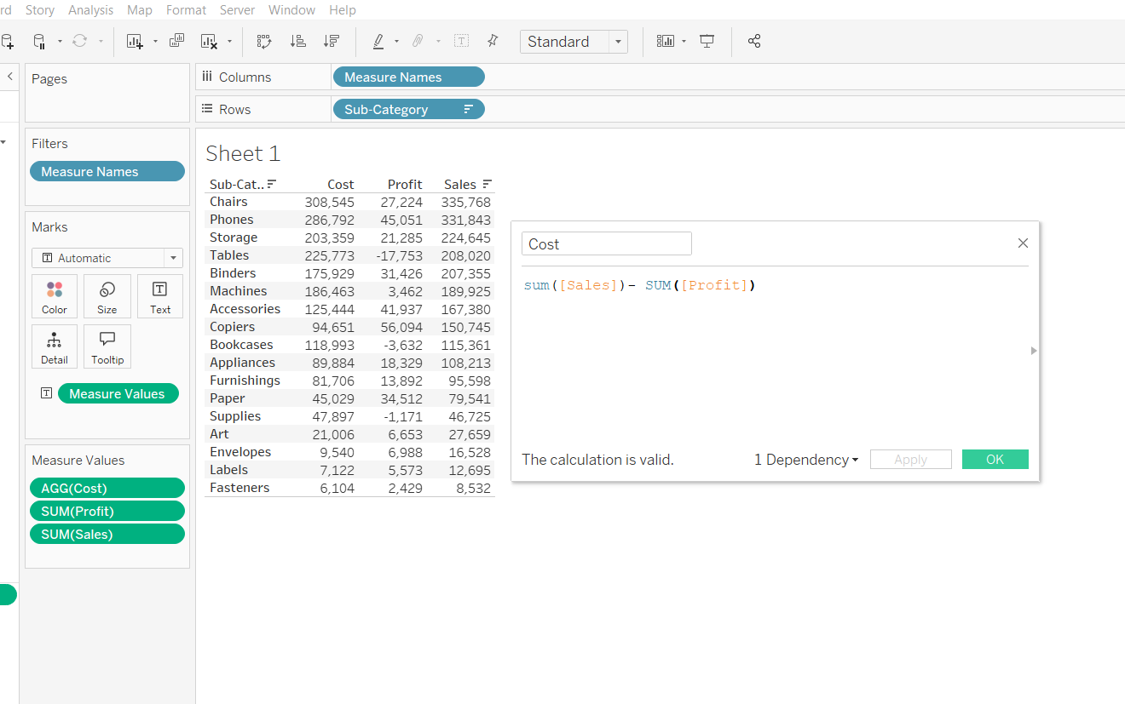
5-Cost

Slide 38
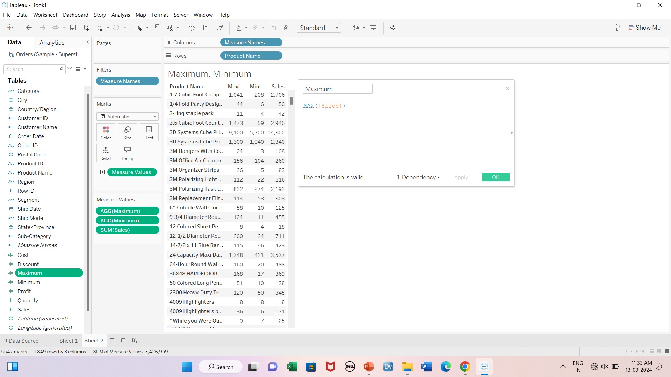
6-Maximum, Minimum

Slide 39
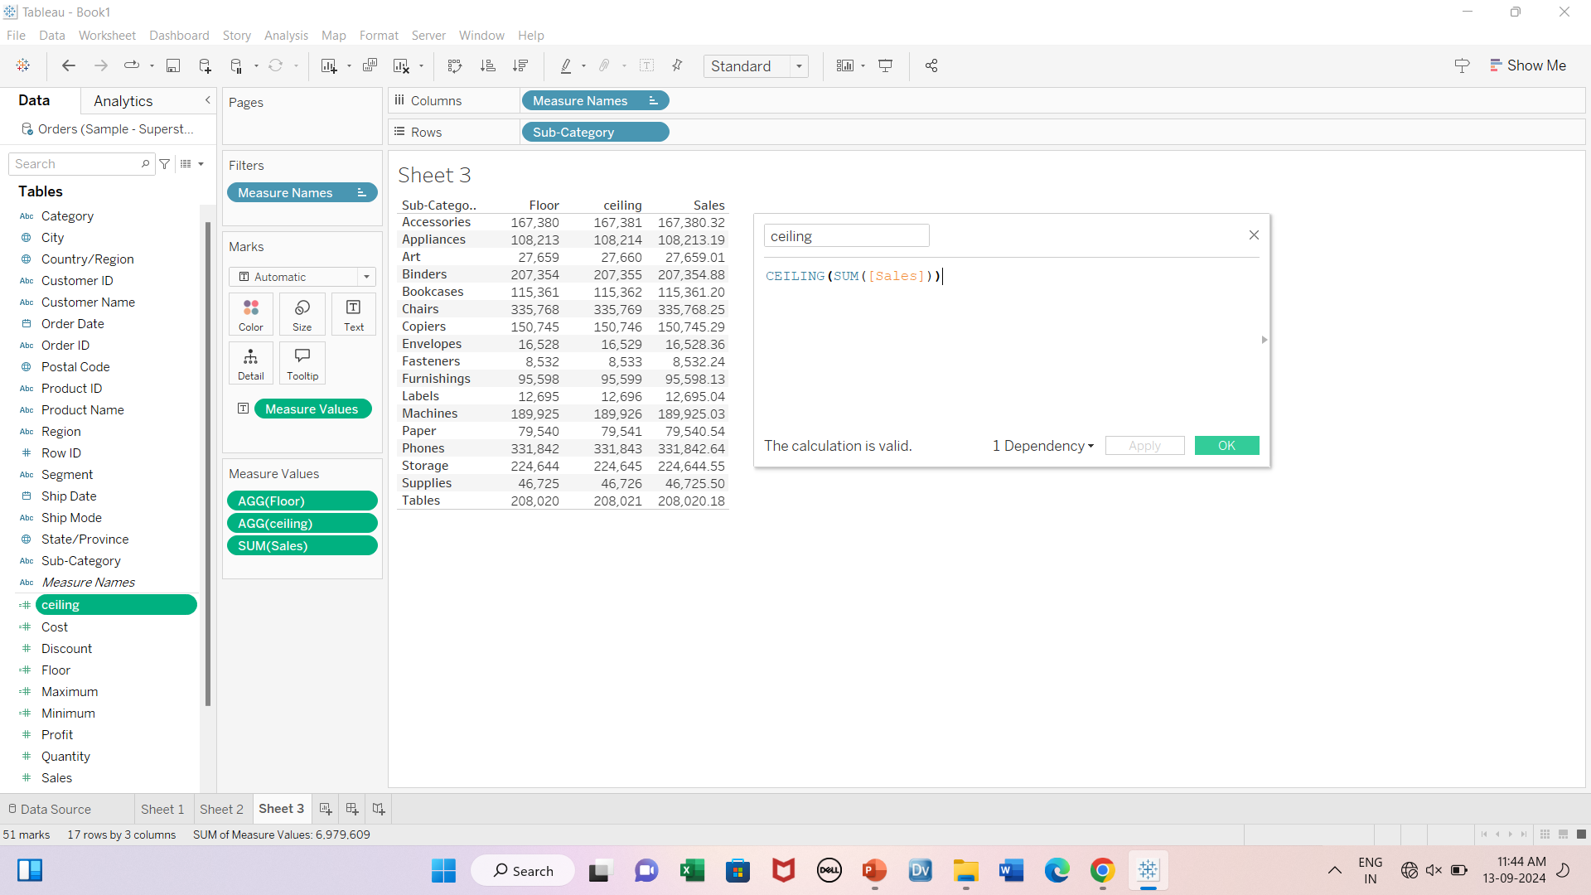
7-Floor, Ceiling

Slide 40
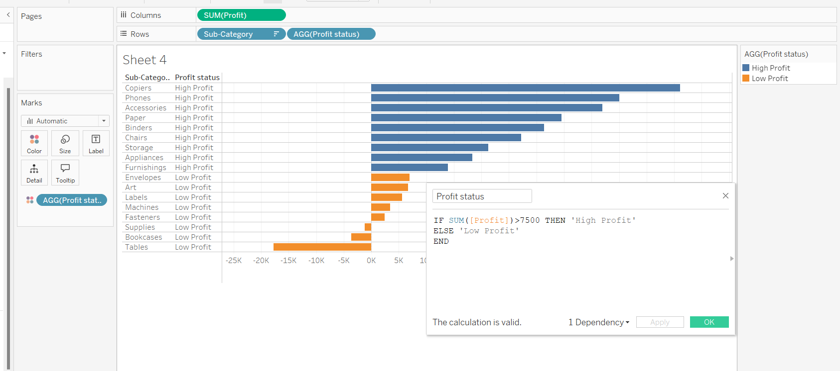
8-IF-Else

Slide 41
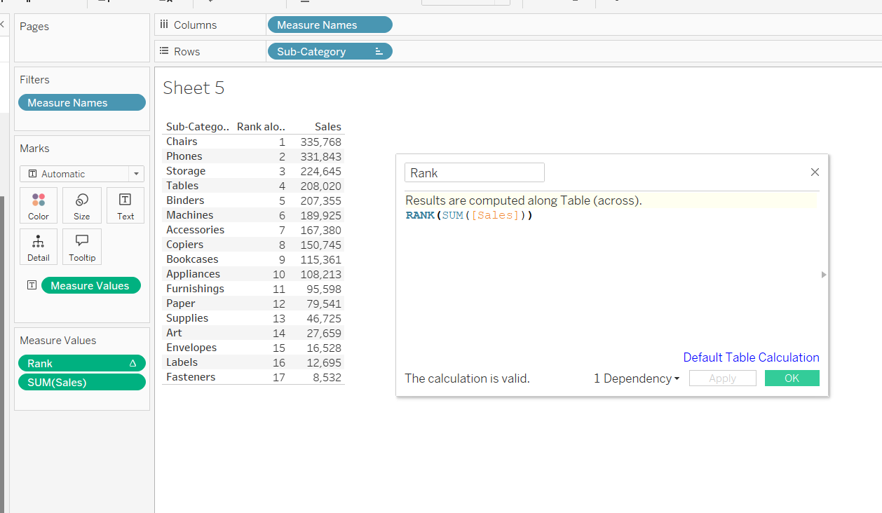
9-Rank

Slide 42
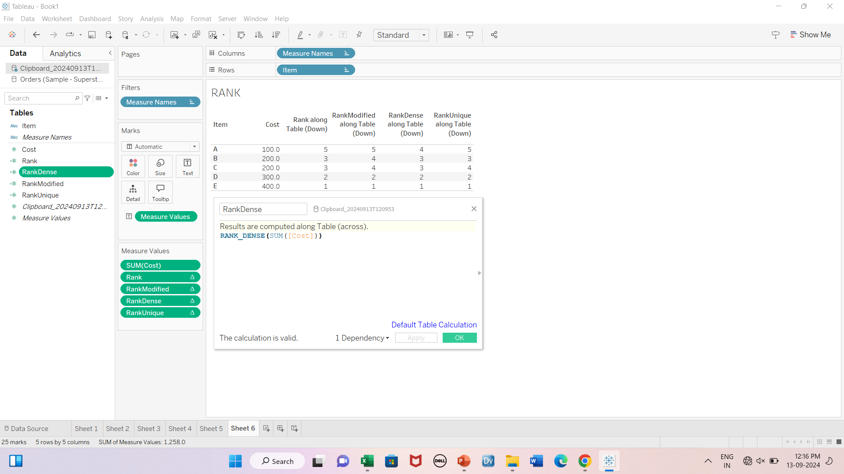
Rank_dense

Slide 43
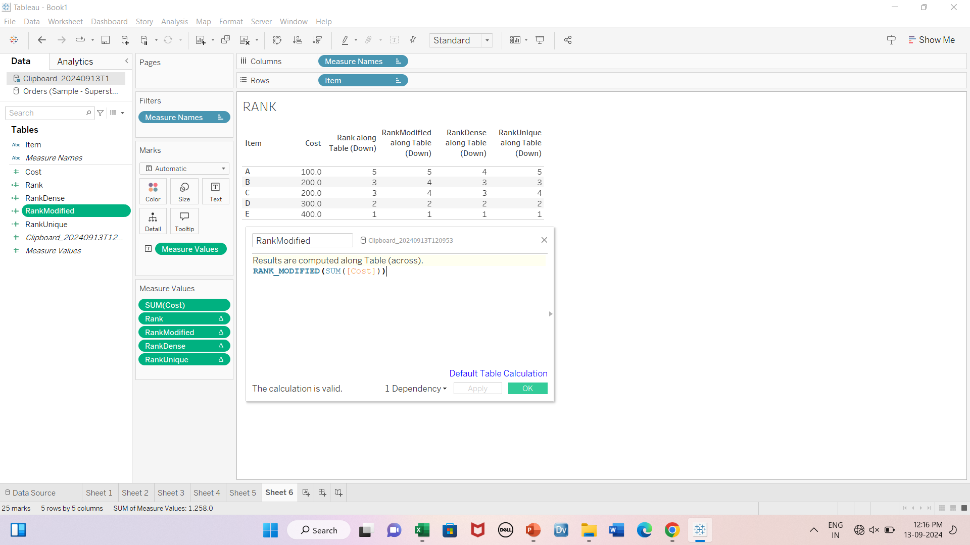
Rank_modified

Slide 44
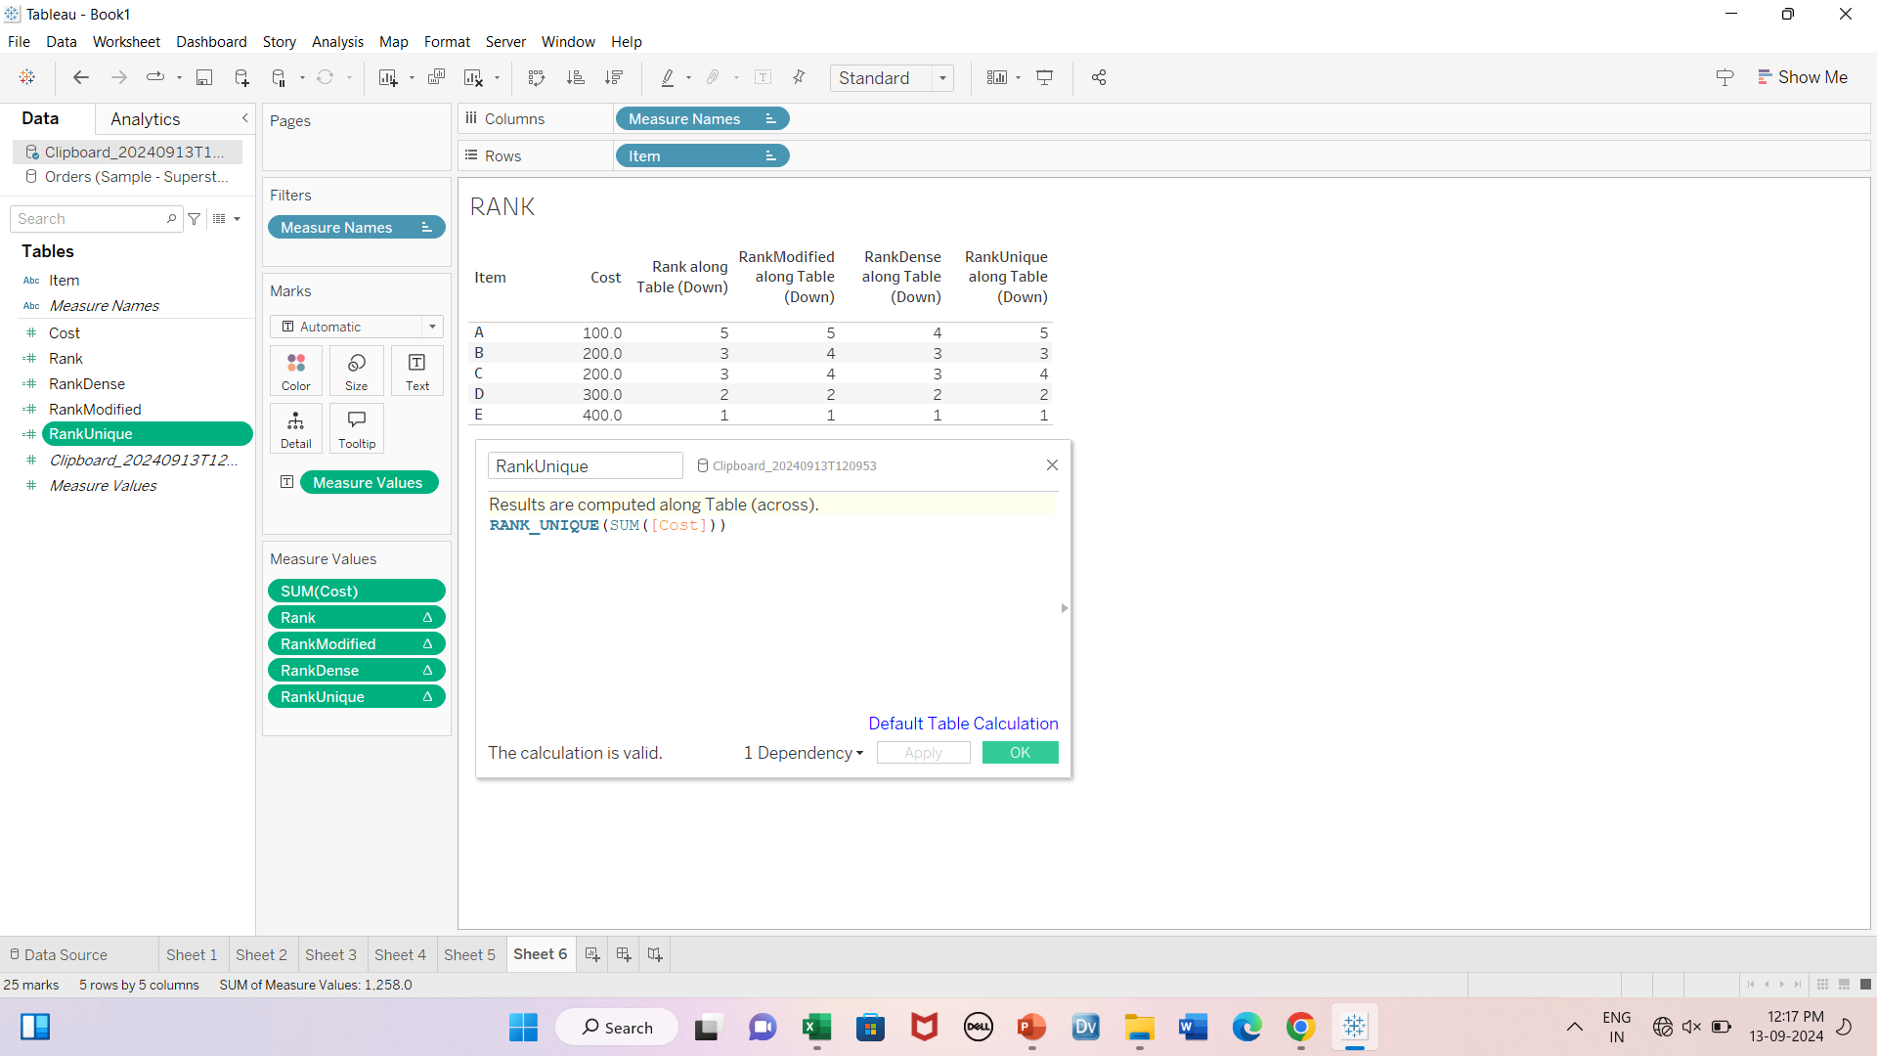
Rank_unique
Note: Order of rank 3 & 4 is being decided based on ASCII values of B & C

Slide 45
Joins
Inner
Left outer
Right outer
Full outer

Slide 46
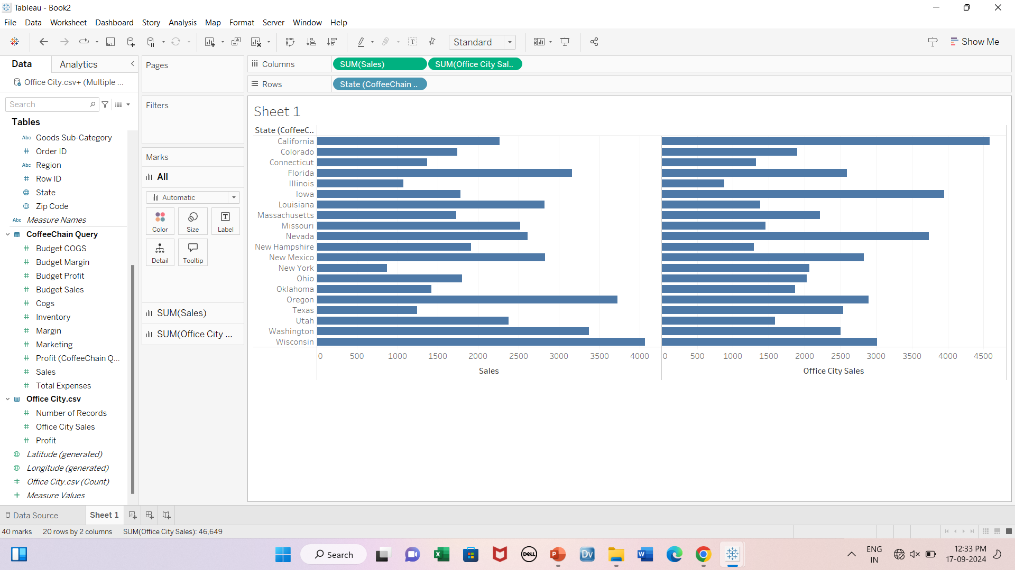
Inner Join

Slide 47
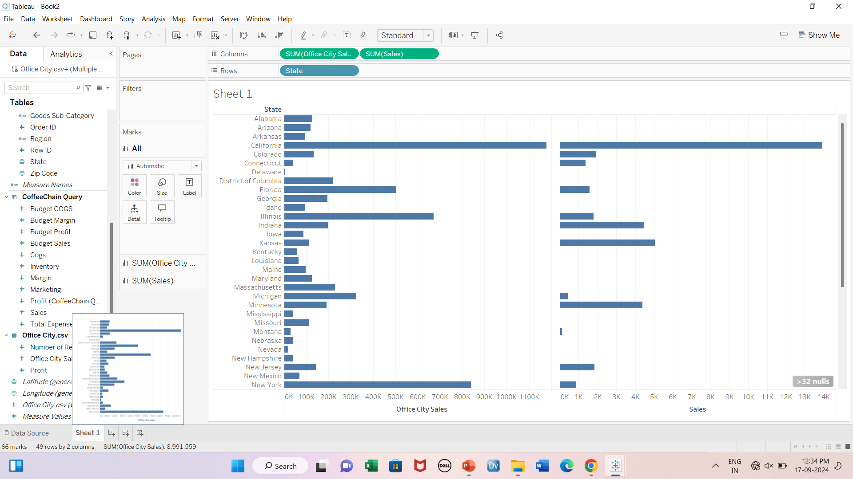
Left join

Slide 48
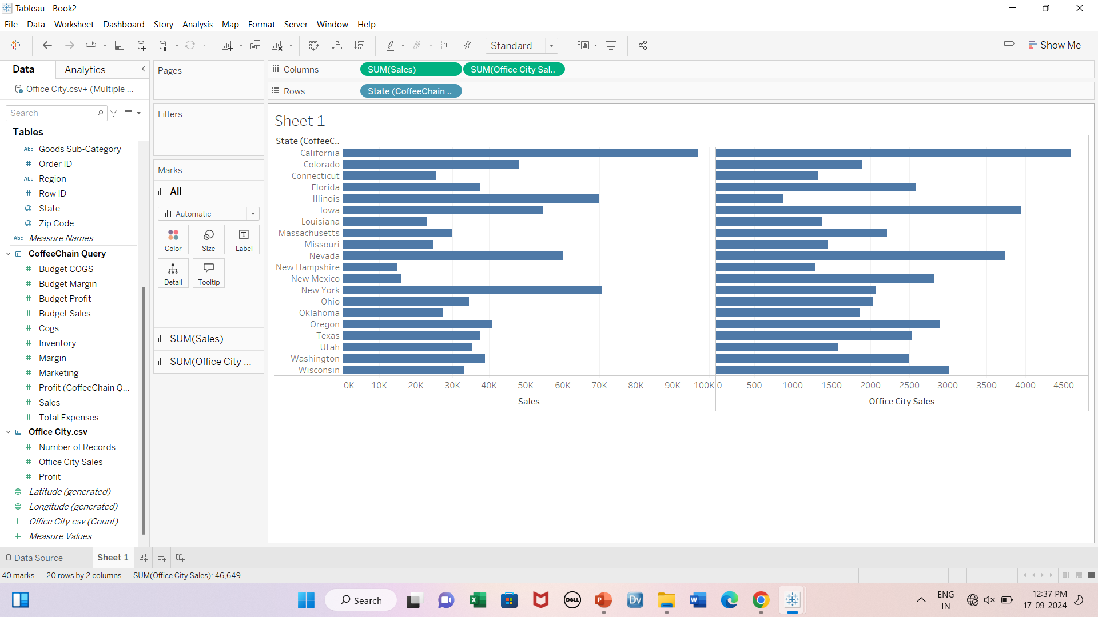
Right join

Slide 49
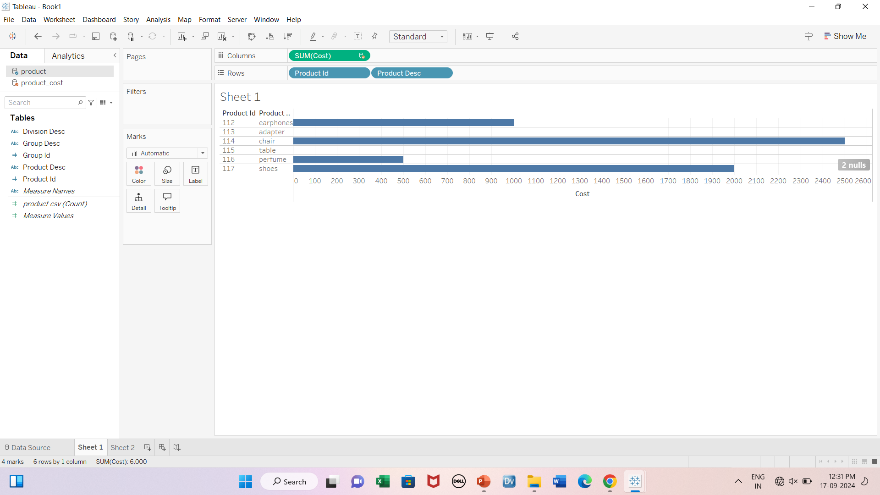
Data blending- example1

Slide 50
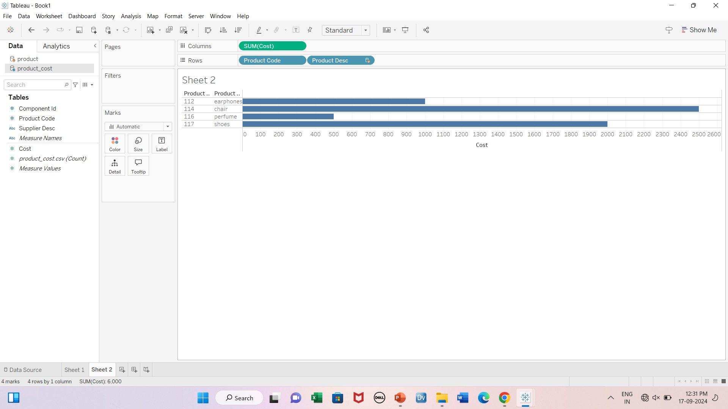

Slide 51
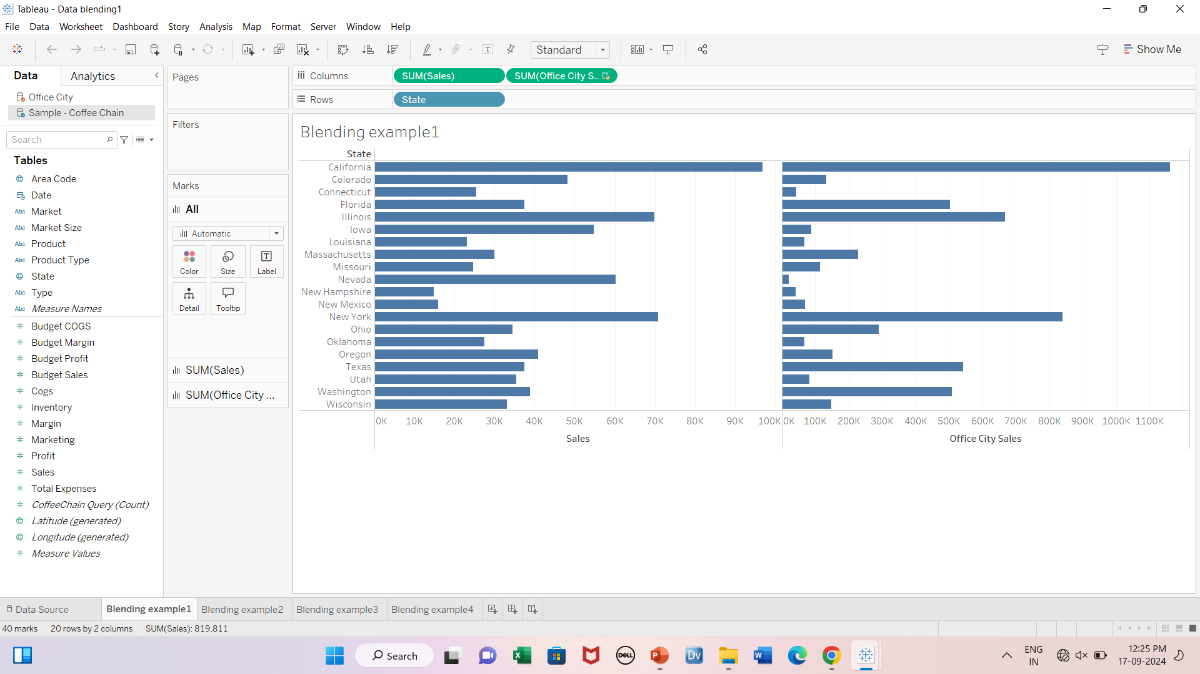
Data blending- example2

Slide 52
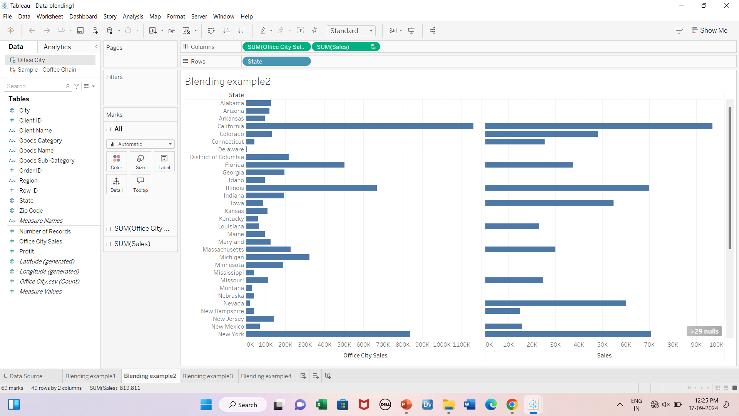

Slide 53
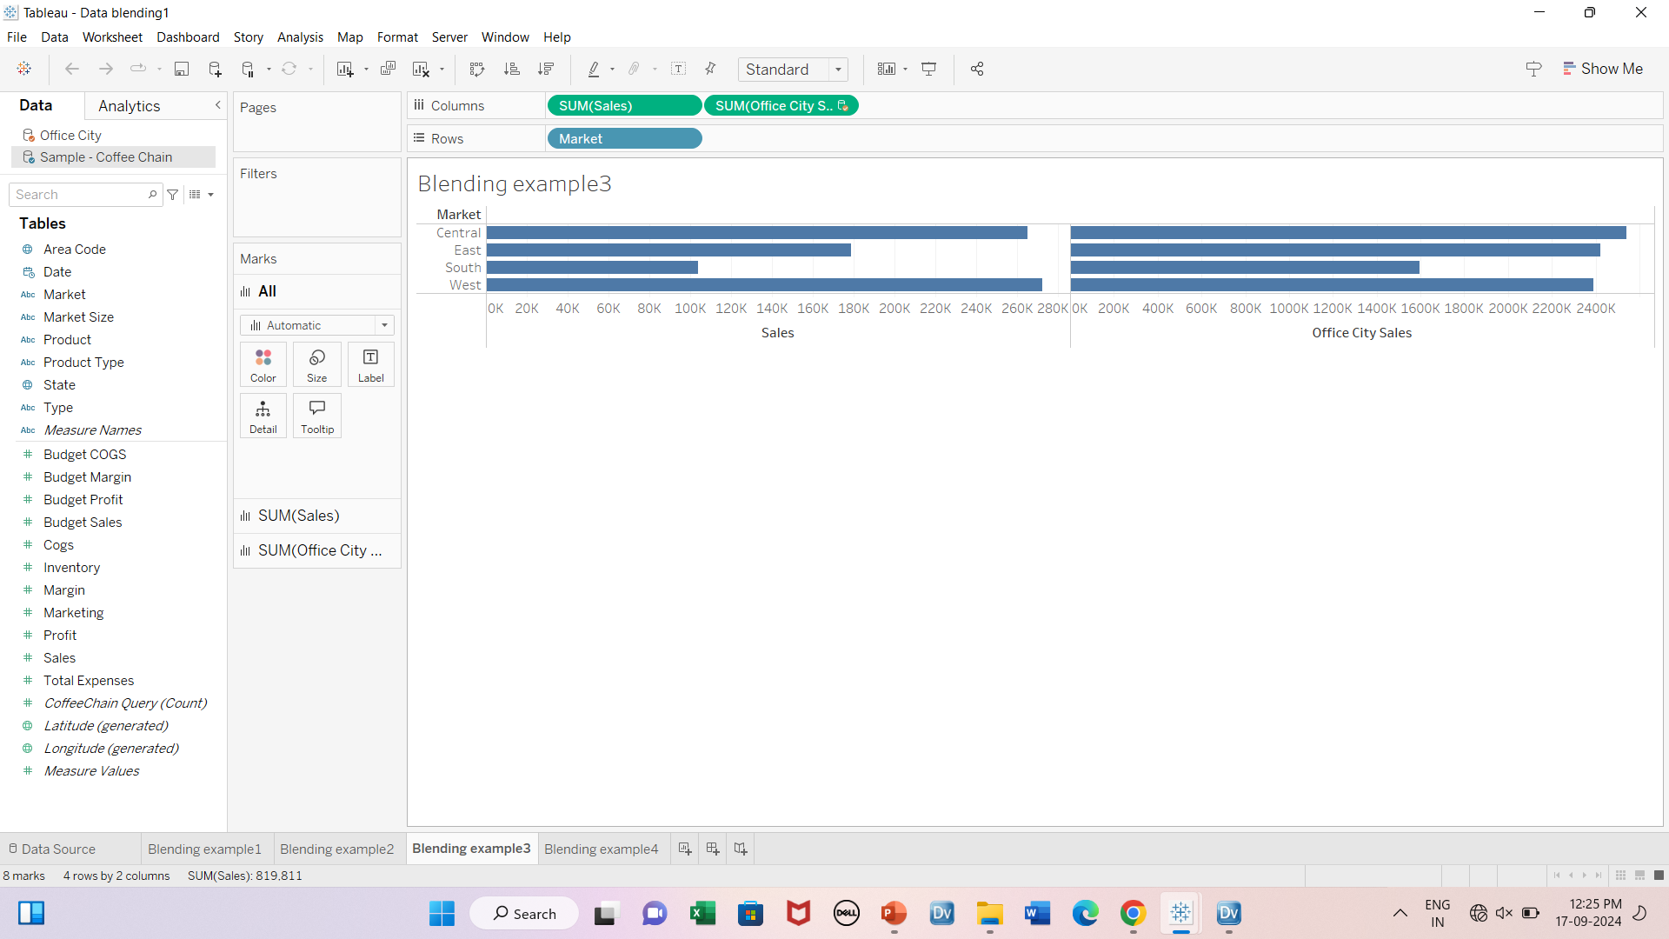

Slide 54
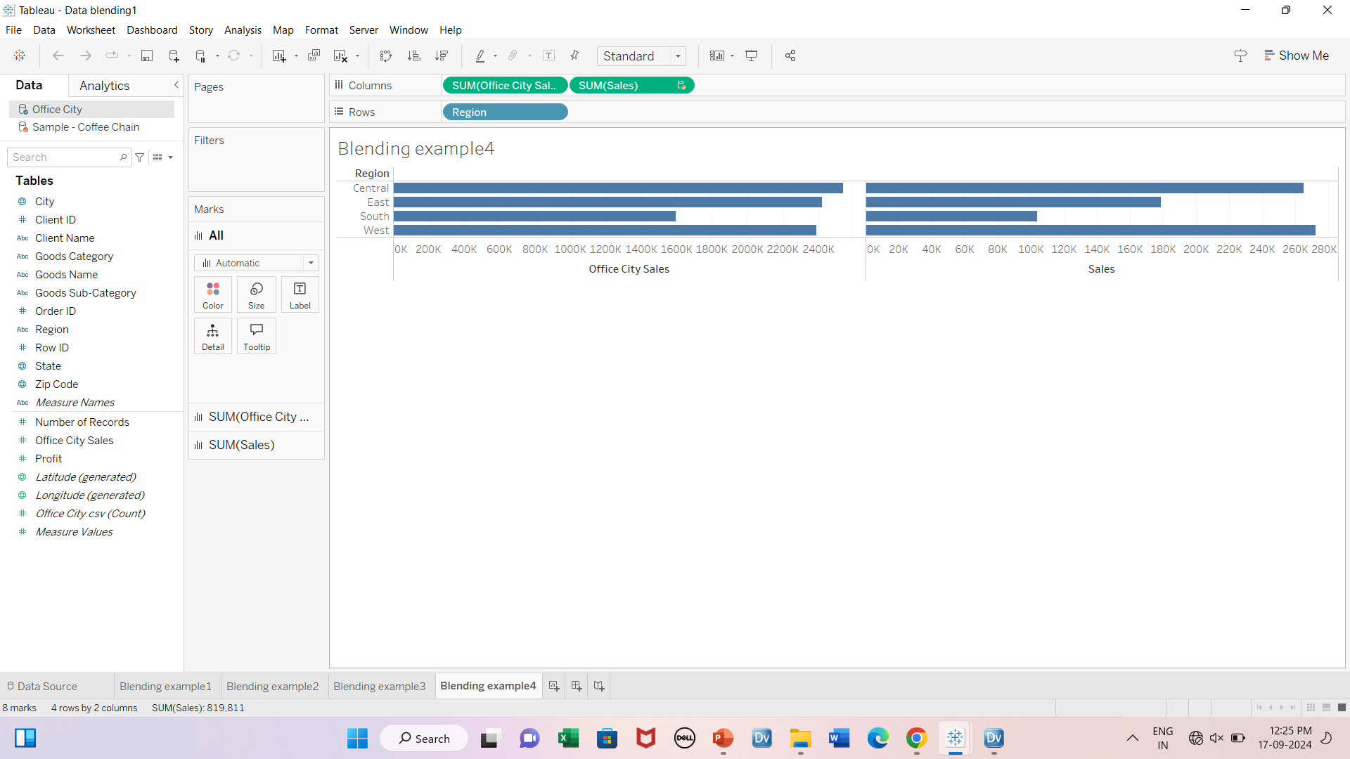

Slide 55
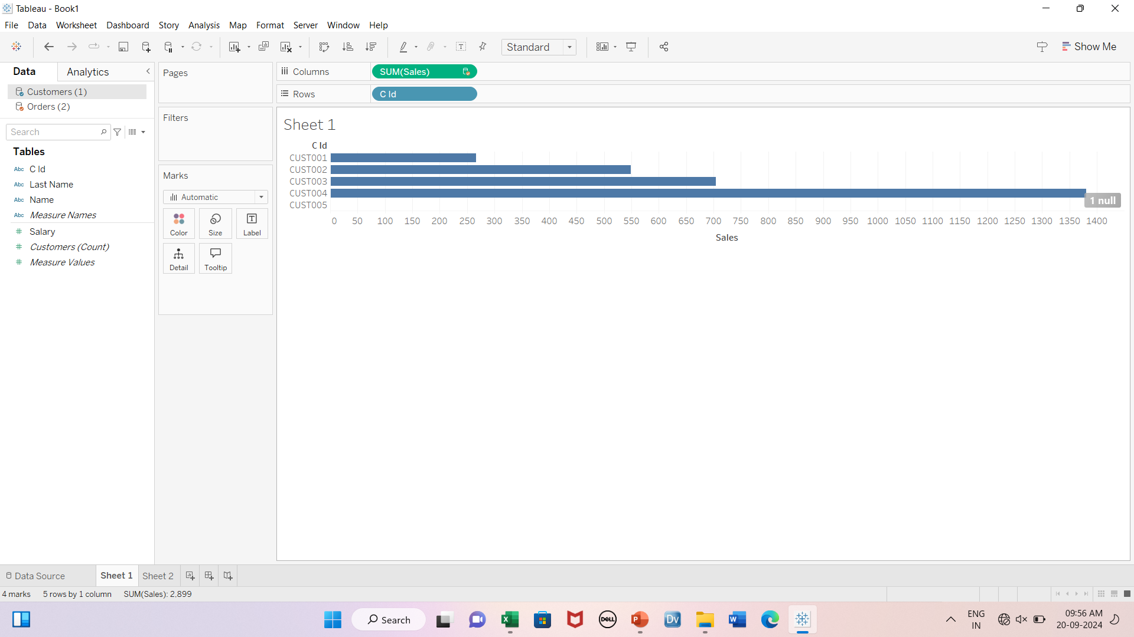
Data Blending- example3 Primary source- customers

Slide 56
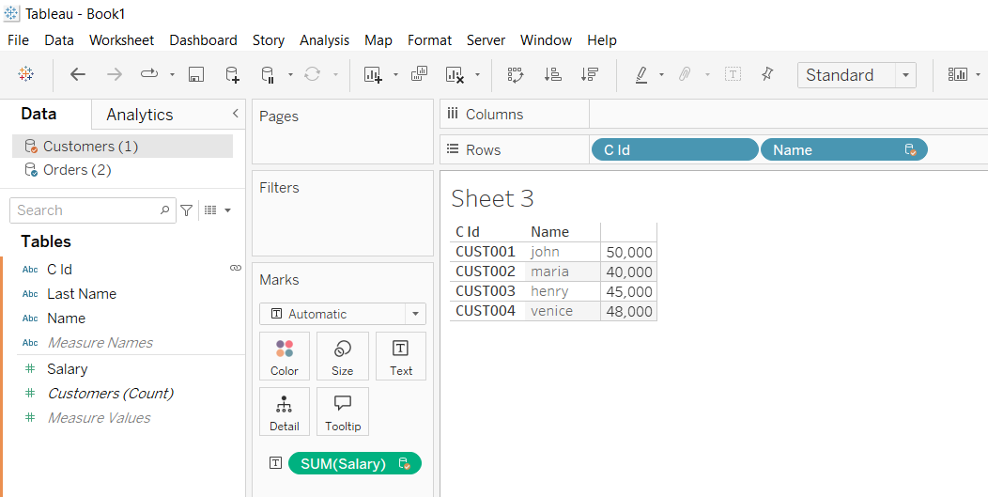
Primary source- orders

Slide 57
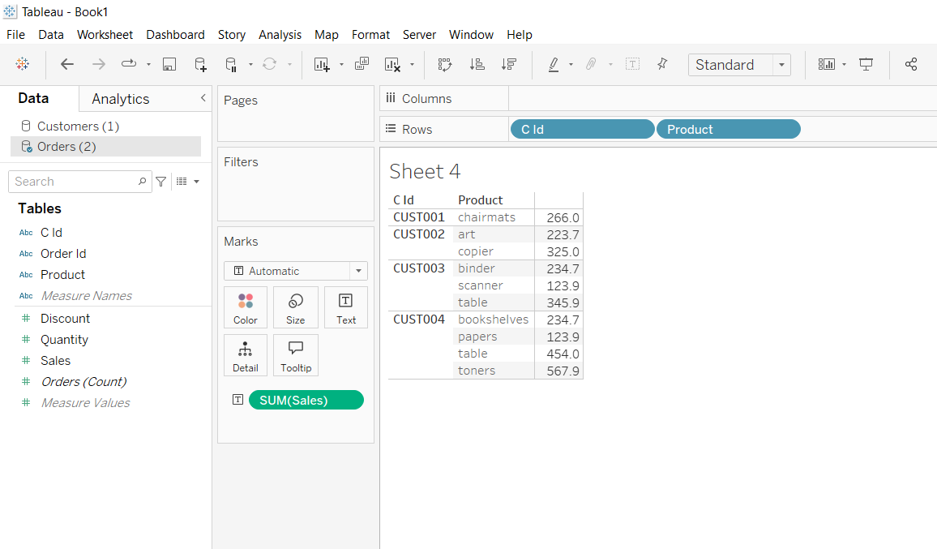
Using only orders table

Slide 58
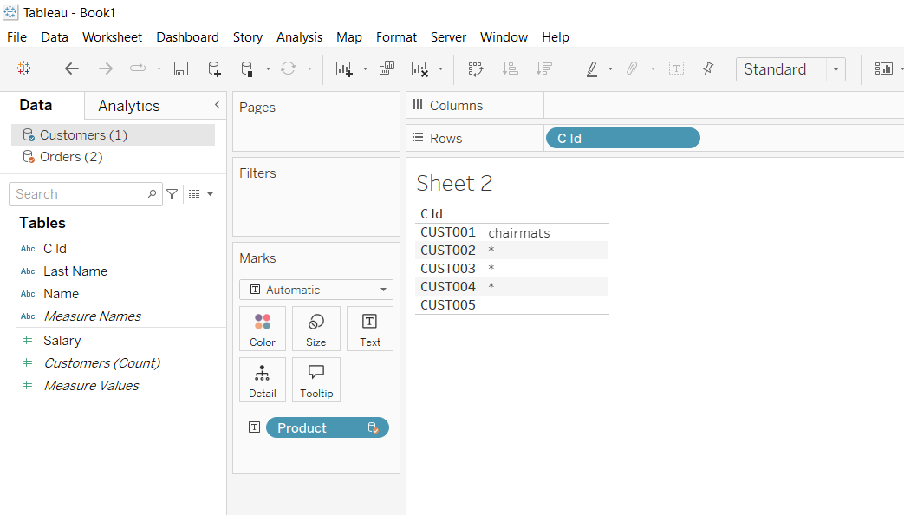
Using customers table as primary source

